Slide 1
A phylogenomic investigation of Scutellaria reveals distinct patterns in medicinal flavonoid diversity
Bryce Askey¹, Yeong Hun Song¹, Yoonkyung Lee², Ru Dai¹, Tong Geon Lee^{1,3,4}, Sangtae Kim², and Jeongim Kim^{1,3}
¹Horticultural Sciences Department, University of Florida, Gainesville, FL, USA
²Department of Biology, Sungshin Women’s University, Seoul, Republic of Korea
³Plant Molecular and Cellular Biology Graduate Program, University of Florida, Gainesville, FL, USA
⁴Gulf Coast Research and Education Center, University of Florida, Wimauma, FL, USA

Slide 2
Table S1. Source of Scutellaria tissue samples
 | Species | Condition | Organ | Herbarium | Voucher ID | Voucher info
1 | S. alpina | Dried | Leaf, stem | Steere herbarium, NY, USA | NYBG02 | T. H. Everett s. n.
2 | S. altissima | Dried | Leaf | Steere herbarium, NY, USA | NYBG01 | Manana Churadze 1007
3 |  | Fresh | Leaf, stem, root
4 | S. angulosa | Dried |  | Steere herbarium, NY, USA | NYBG69 | K. M. Naid s. n.
5 | S. angustifolia ssp. angustifolia | Dried |  | Steere herbarium, NY, USA | NYBG04 | R. Olmstead 558
6 | S. angustifolia ssp. micrathum | Dried |  | Steere herbarium, NY, USA | NYBG03 | Arnold Tiehm 16758
7 | S. antirrhinoides | Dried |  | Steere herbarium, NY, USA | NYBG05 | N. D. Atwood 28625
8 | S. arenicola | Dried |  | University of Florida herbarium, FL, USA
9 |  | Fresh | Leaf, stem, root
10 | S. astinae | Dried | Leaf, stem | Steere herbarium, NY, USA | NYBG06 | John Thomas Howell 38532
11 | S. baicalensis | Fresh | Leaf, stem, root
12 | S. barbata | Fresh | Leaf, stem, root
13 |  | Fresh | Leaf, stem, root | KR
14 | S. blepharophylla | Dried |  | Steere herbarium, NY, USA | NYBG38 | G. B. H. 1086
15 | S. brittonii | Dried |  | Steere herbarium, NY, USA | NYBG07 | Steven P. Churchill 7376
16 | S. californica | Dried |  | Steere herbarium, NY, USA | NYBG08 | R. Olmstead 434
17 | S. coccinea | Dried |  | Steere herbarium, NY, USA | NYBG09 | D. Cardenas et al. 42257
18 | S. coerulea | Dried | Leaf | Steere herbarium, NY, USA | NYBG39 | T. Sultan Quedensley 10037
19 | S. costaricana | Dried | Leaf, stem | Steere herbarium, NY, USA | NYBG40 | Arthur Cronquist 8834
20 | S. dependens | Fresh | Leaf, stem, root | KR
21 | S. discolor | Dried |  | Steere herbarium, NY, USA | NYBG58 | A. A. Bullock 740
22 | S. drumondii | Dried |  | Steere herbarium, NY, USA | NYBG10 | Larry C. Higgins 17229
23 | S. elliptica | Dried |  | University of Florida herbarium, FL, USA
24 | S. epilobiifolia | Dried | Leaf, stem | Steere herbarium, NY, USA | NYBG11 | C. E. Garton 22860
25 | S. formosa | Dried | Leaf, stem | Steere herbarium, NY, USA | NYBG41 | H. et al. 11073
26 | S. fruticosa | Dried | Leaf | Steere herbarium, NY, USA | NYBG59 | Henry Field & Yusuf Lazar s. n.
27 | S. galericulata | Dried | Leaf, stem | Steere herbarium, NY, USA | NYBG12 | D. Erskine & A. J. Smith 2118
28 | S. glabriuscula | Dried |  | Steere herbarium, NY, USA | NYBG13 | R. Kral s. n.
29 | S. guatemalensis | Dried |  | Steere herbarium, NY, USA | NYBG44 | Demetrio Alvarez 11028
30 | S. havanensis | Dried |  | Steere herbarium, NY, USA | NYBG14 | J. K. Small s. n.
31 |  | Fresh | Leaf, stem, root
32 | S. heterophylla | Dried |  | Steere herbarium, NY, USA | NYBG62 | A. Bertschinger s. n.
33 | S. heydei | Dried |  | Steere herbarium, NY, USA | NYBG63 | Walter Koelz 6242
34 | S. hispidula | Dried |  | Steere herbarium, NY, USA | NYBG42 | R. D. Worthington 12501
35 | S. holmgreniorum | Dried | Leaf, stem | Steere herbarium, NY, USA | NYBG15 | Gary Schoolcraft 1222
36 | S. hookeri | Dried | Leaf, stem | Steere herbarium, NY, USA | NYBG43 | L. O. Willioms et al. 28585
37 | S. incanca | Dried |  | Steere herbarium, NY, USA | NYBG17 | R. Dale Thomas 150388
38 | S. indica var. coccinea | Fresh | Leaf, stem, root | KR
39 | S. insignis | Fresh | Leaf, stem, root | KR
40 | S. integrifolia | Dried |  | University of Florida herbarium, FL, USA
41 | S. isochelia | Dried | Leaf, stem | Steere herbarium, NY, USA | NYBG45 | Alberto M. Brenes s. n.
42 | S. javalambrensis | Dried |  | Steere herbarium, NY, USA | NYBG73 | A. Charpin et al. s. n.
43 | S. javanica | Dried |  | Steere herbarium, NY, USA | NYBG64 | Lau, S. K. 1915
44 | S. lateriflora | Dried | Leaf | Steere herbarium, NY, USA | NYBG18 | George F. buddell II 2352
45 |  | Fresh | Leaf, stem, root
46 | S. leonardii | Dried |  | Steere herbarium, NY, USA | NYBG19 | J. C. Arthwz s. n.
47 |  | Fresh | Leaf, stem, root
48 | S. leptosiplonsipkon | Dried |  | Steere herbarium, NY, USA | NYBG74 | L. Maplcoba s. n.
49 | S. longifolia | Dried | Leaf, stem | Steere herbarium, NY, USA | NYBG47 | J. J. Castillo & J. M. Vargas 2722

Slide 3
Table S1 cont. Source of Scutellaria tissue samples
 | Species | Condition | Organ | Herbarium | Voucher ID | Voucher info
50 | S. lutea | Dried |  | Steere herbarium, NY, USA | NYBG48 | Jorge A. Molina 30005
51 | S. lutilaba | Dried | Leaf, stem | Steere herbarium, NY, USA | NYBG20 | Hinton et al. 21760
52 | S. microphylla | Dried | Leaf, stem, root | Steere herbarium, NY, USA | NYBG49 | H. D. Ripley 14966
53 | S. multicularis | Dried |  | Steere herbarium, NY, USA | NYBG60 | Assadi, Edmondson & Miller 2135
54 | S. multiglandulosa | Dried |  | Steere herbarium, NY, USA | NYBG22 | D. S. & H. B. Correll 51703
55 | S. multiglandulosa | Dried |  | University of Florida herbarium, FL, USA
56 | S. muriculata | Dried |  | Steere herbarium, NY, USA | NYBG23 | C. L. Lundell 14978
57 | S. oblonga | Dried |  | Steere herbarium, NY, USA | NYBG61 | L. H. Cramer 4871
58 | S. orientalis | Dried | Leaf, stem | Steere herbarium, NY, USA | NYBG54 | E. Serowa & E. Ryschowa s. n.
59 | S. ovata | Dried | Leaf | Steere herbarium, NY, USA | NYBG26 | R. Dale Thomas et al. 170488
60 | S. parvula | Dried | Leaf, stem | Steere herbarium, NY, USA | NYBG27 | R. Dale Thomas & Cecil Slaughter 103883
61 | S. paucifolia | Dried |  | Steere herbarium, NY, USA | NYBG71 | Paul Jaeger 8796
62 | S. pekinensis var. alpina | Fresh | Leaf, stem, root | KR
63 | S. peregrina | Dried |  | Steere herbarium, NY, USA | NYBG67 | Henry Field & Yusuf Lazar s. n.
64 | S. pinnatifida | Dried |  | Steere herbarium, NY, USA | NYBG65 | K. H. Rechinger 686
65 | S. potosina | Dried | Leaf, stem | Steere herbarium, NY, USA | NYBG28 | D. S. & H. B. Correll 30562
66 | S. prostrata | Dried |  | Steere herbarium, NY, USA | NYBG66 | Walter Koelz 21180
67 | S. przewalskii | Dried |  | Steere herbarium, NY, USA | NYBG56 | L. Janczenko s. n.
68 | S. pseudoserrata | Dried |  | Steere herbarium, NY, USA | NYBG29 | R. Kral s. n.
69 | S. pulchella | Dried | Root | Steere herbarium, NY, USA | NYBG55 | R. Schischkin et al. s. n.
70 | S. purpurascens | Dried |  | Steere herbarium, NY, USA | NYBG50 | Alberto M. Brenes s. n.
71 | S. racemosa | Dried |  | University of Florida herbarium, FL, USA
72 |  | Fresh | Leaf, stem, root
73 | S. relenorskyi | Dried |  | Steere herbarium, NY, USA | NYBG68 | A. Donmez 3627
74 | S. resinosa | Dried | Leaf, stem | Steere herbarium, NY, USA | NYBG31 | Graig C. Freeman & Ralph E. Brooks 3682
75 | S. sapphirina | Dried | Leaf, stem | Steere herbarium, NY, USA | NYBG32 | S. L. Welsh 20585
76 | S. scordiifolia | Dried |  | Steere herbarium, NY, USA | NYBG57 | H. H. Iltis et al. 307
77 | S. seleriana | Dried |  | Steere herbarium, NY, USA | NYBG51 | C. G. Pringle s. n.
78 | S. serrata | Dried | Leaf | Steere herbarium, NY, USA | NYBG33 | J. J. Carter s. n.
79 | S. siphocampuloides | Dried | Leaf, stem | Steere herbarium, NY, USA | NYBG35 | Scott D. White 4380
80 | S. splendens | Dried | Leaf | Steere herbarium, NY, USA | NYBG52 | A. Villegas H. 00063
81 | S. strigillosa | Fresh | Leaf, stem, root | KR
82 | S. suffrutscens | Dried |  | Steere herbarium, NY, USA | NYBG53 | James L. Reveal 3390
83 | S. sumatrana | Dried |  | Steere herbarium, NY, USA | NYBG72 | Carel Hamel & Rahmat Si Toroes 767
84 | S. tessellata | Dried | Leaf, stem | Steere herbarium, NY, USA | NYBG36 | R. D. Worthington 13323
85 | S. tournefortii | Fresh | Leaf, stem, root

Slide 4
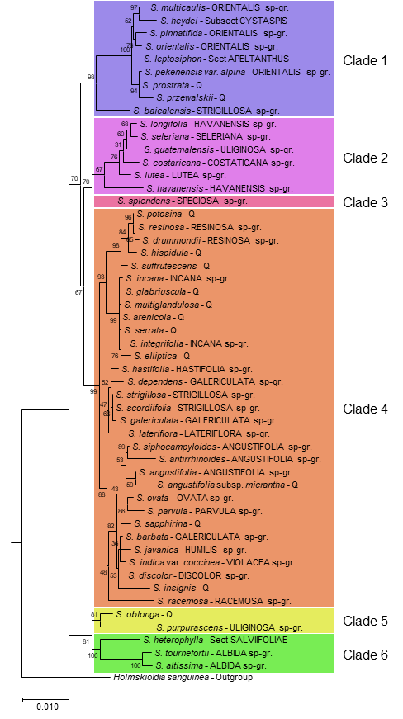
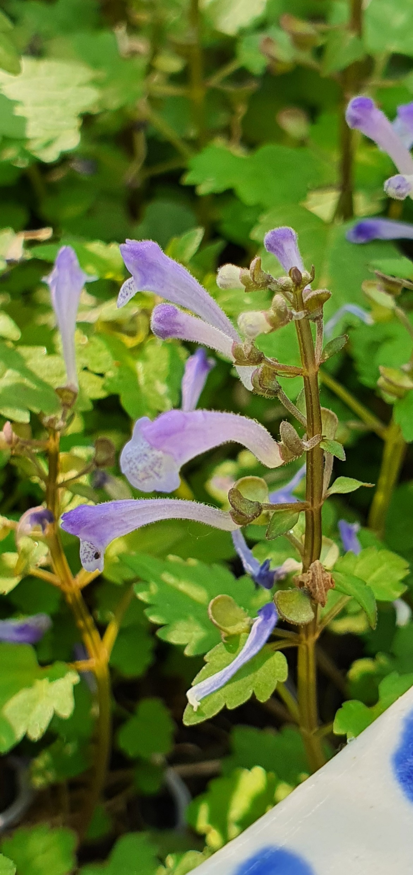
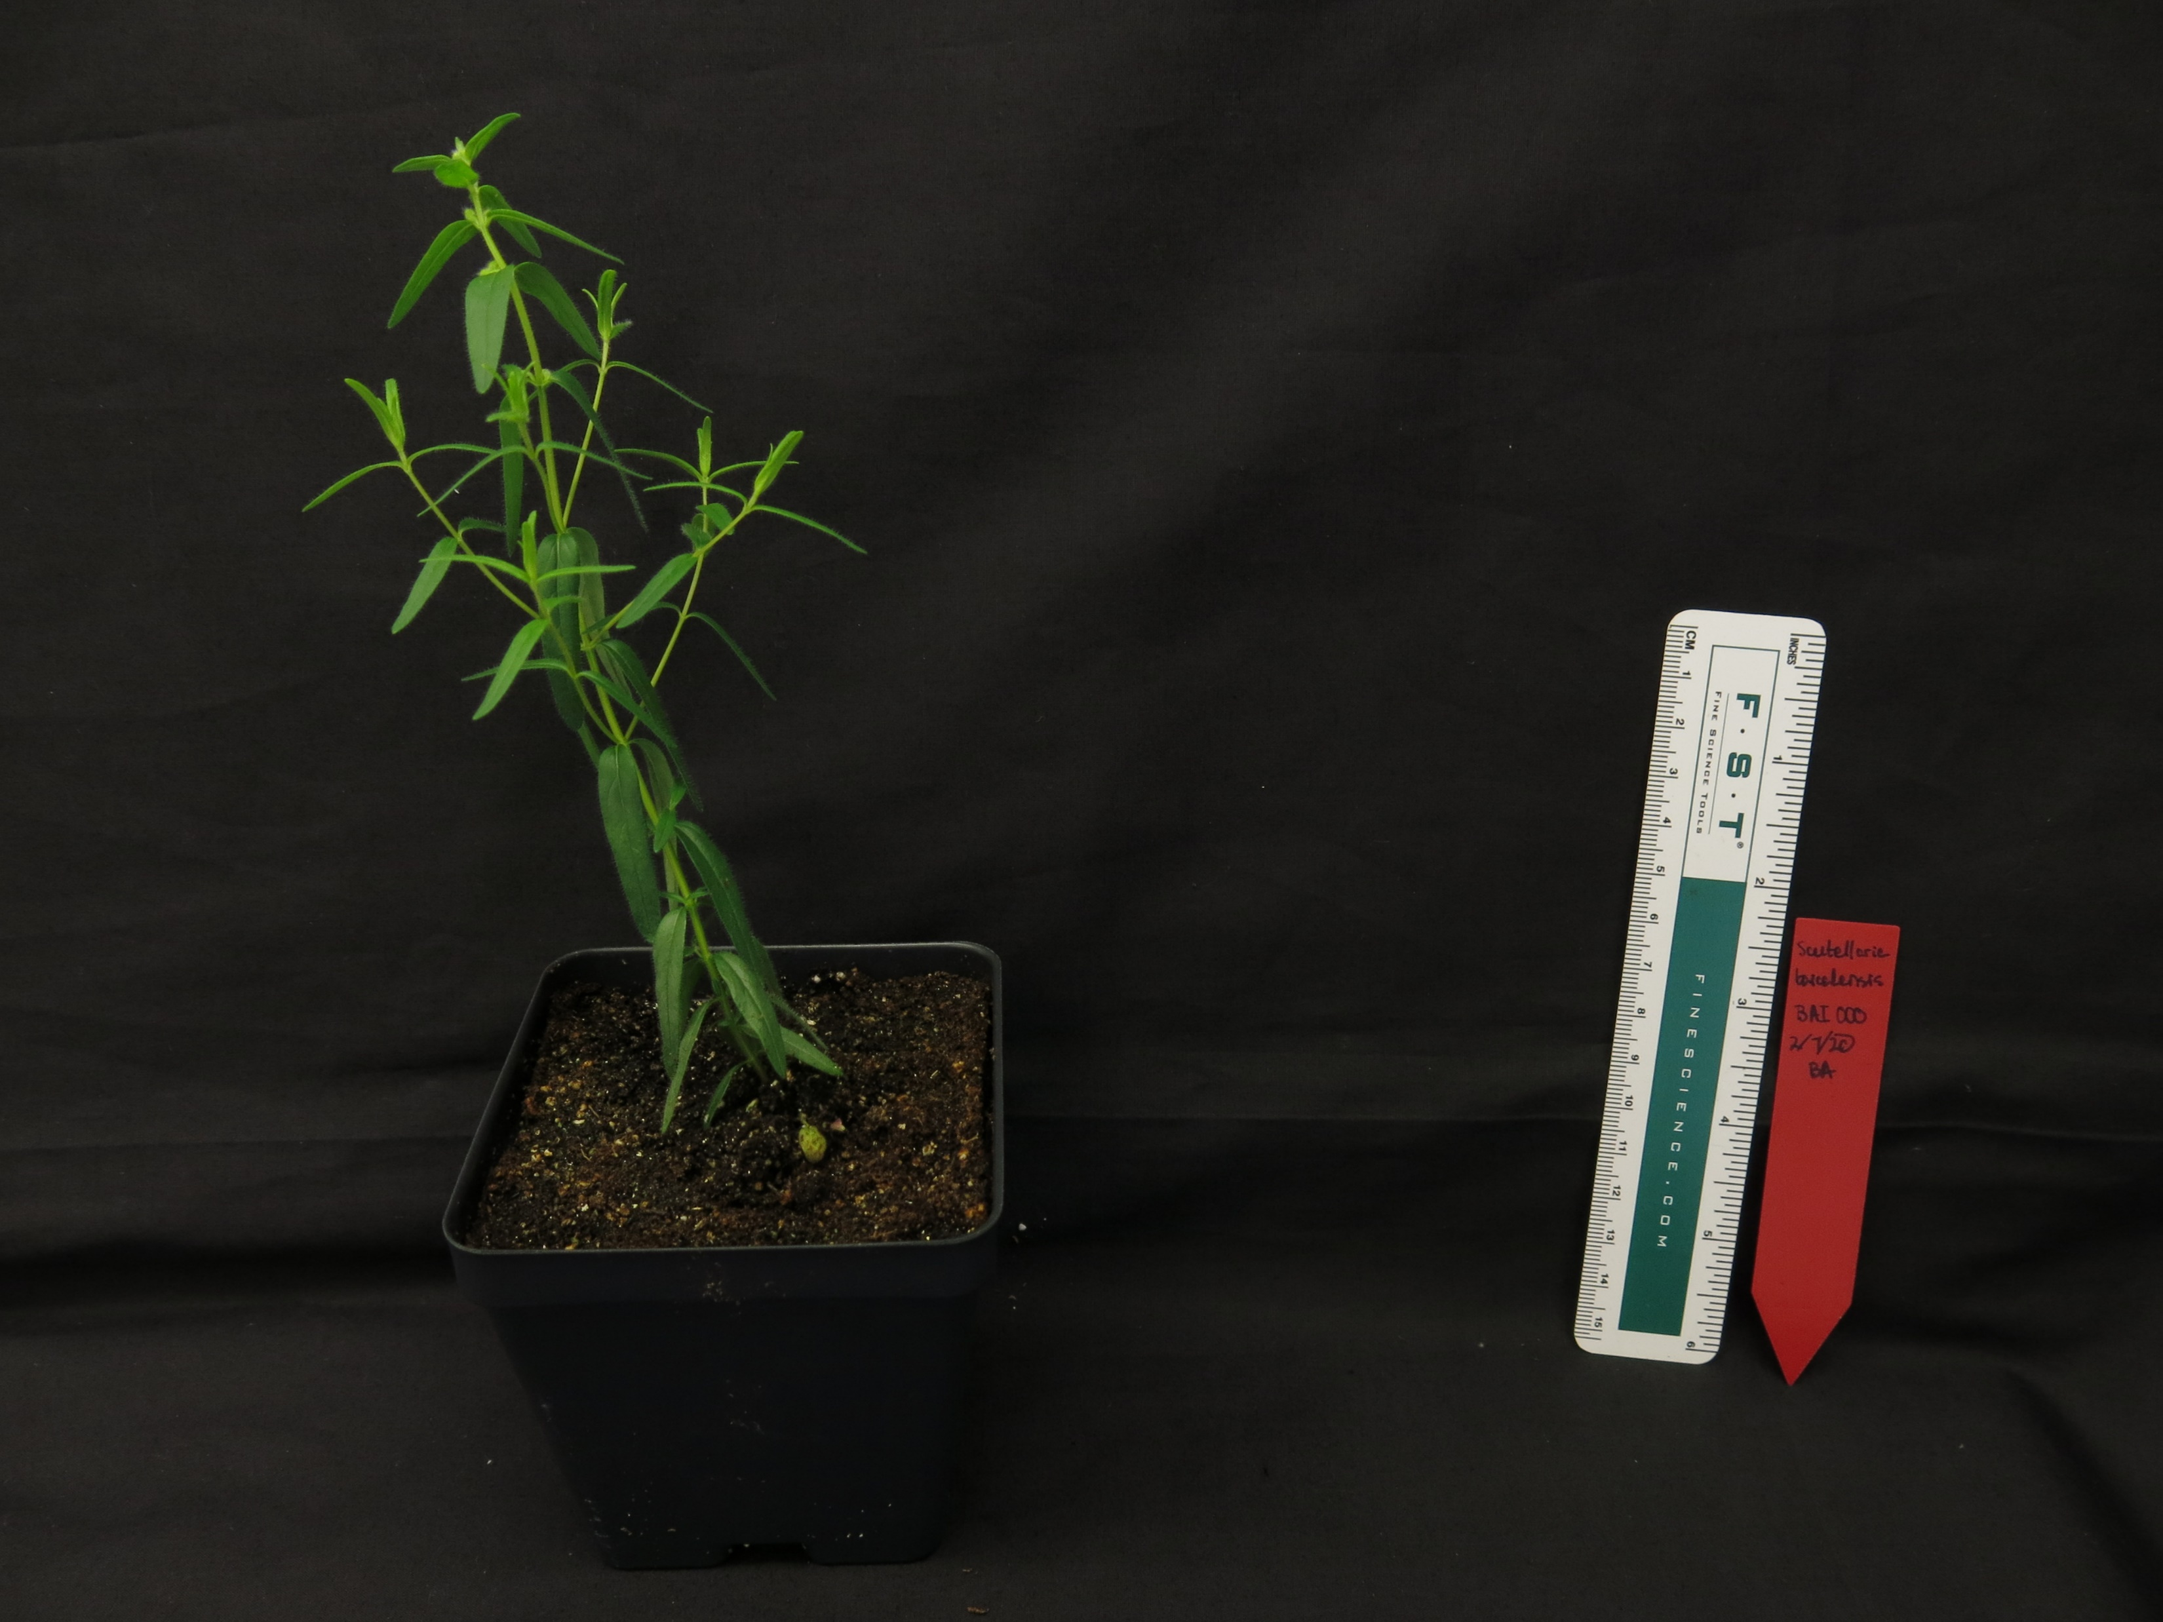
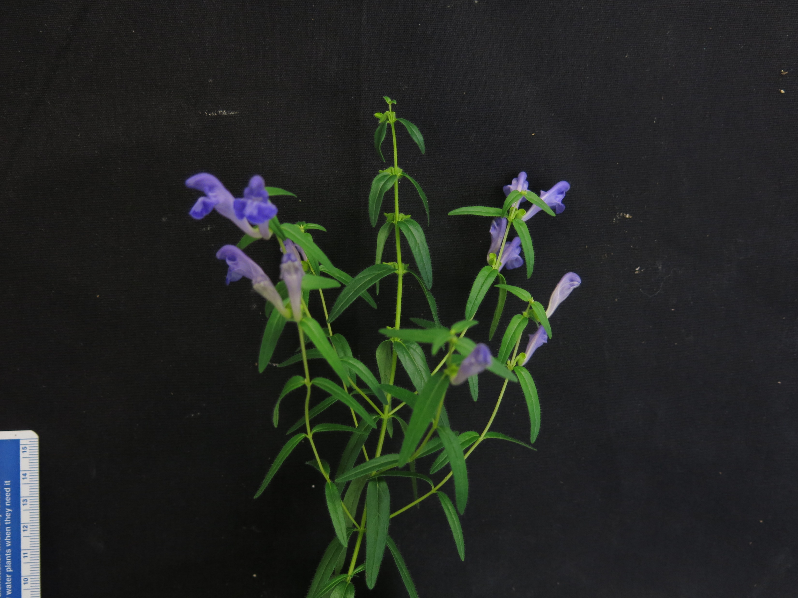
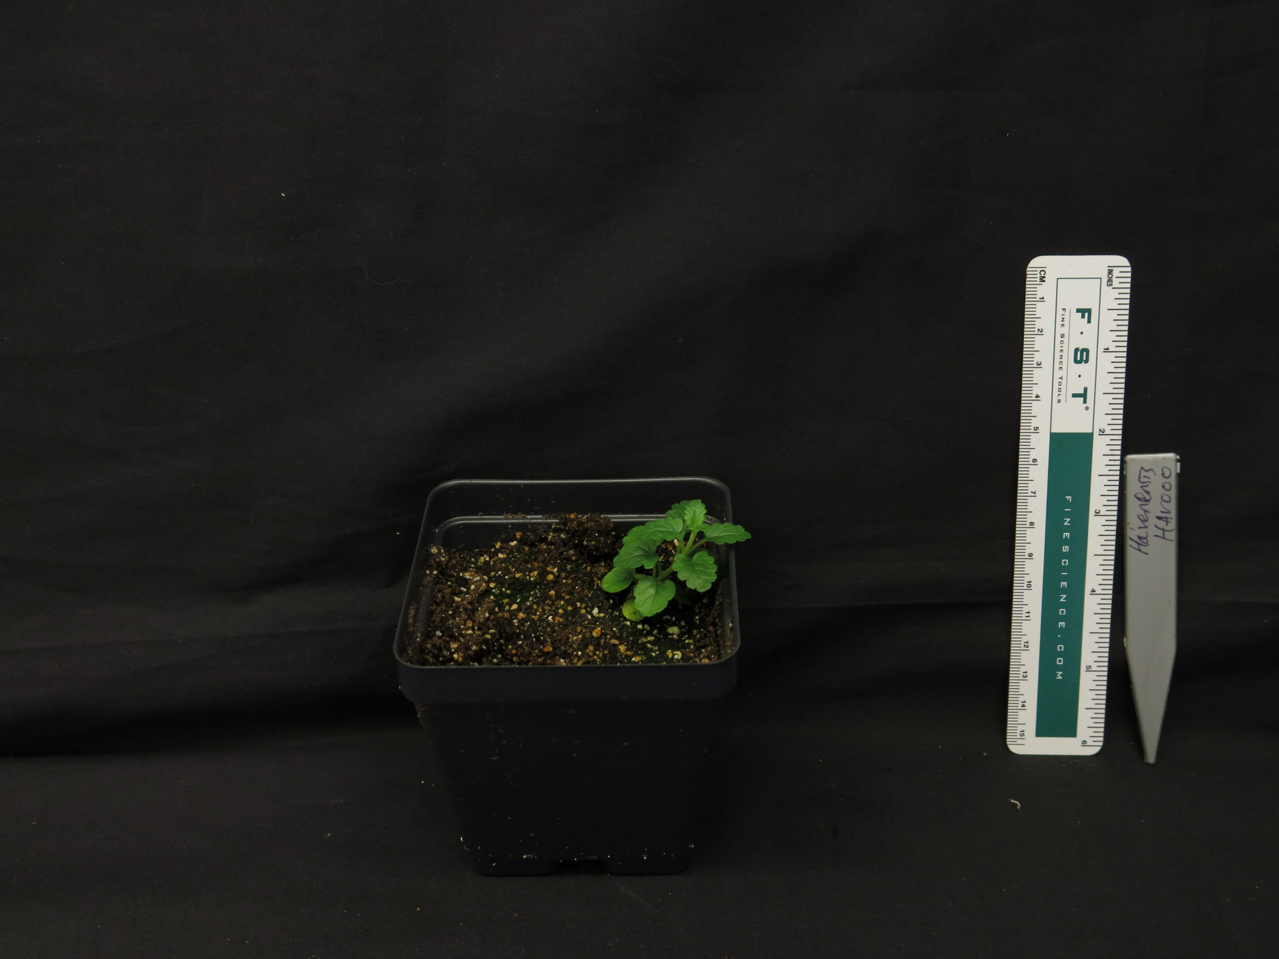
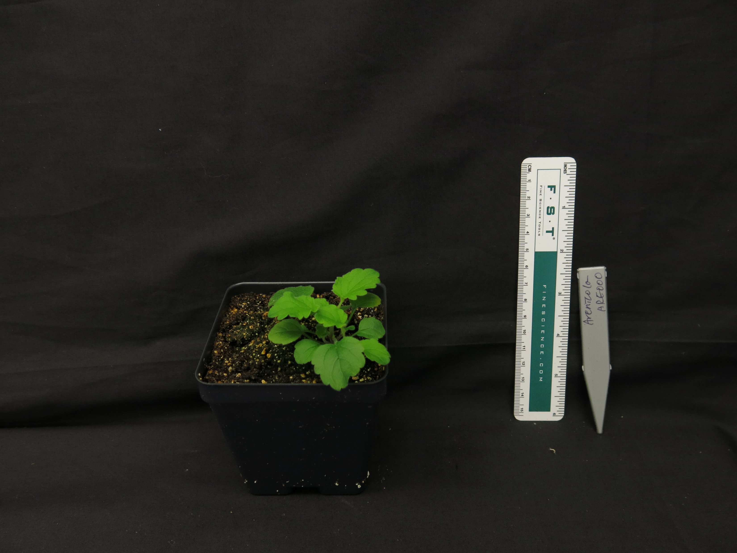
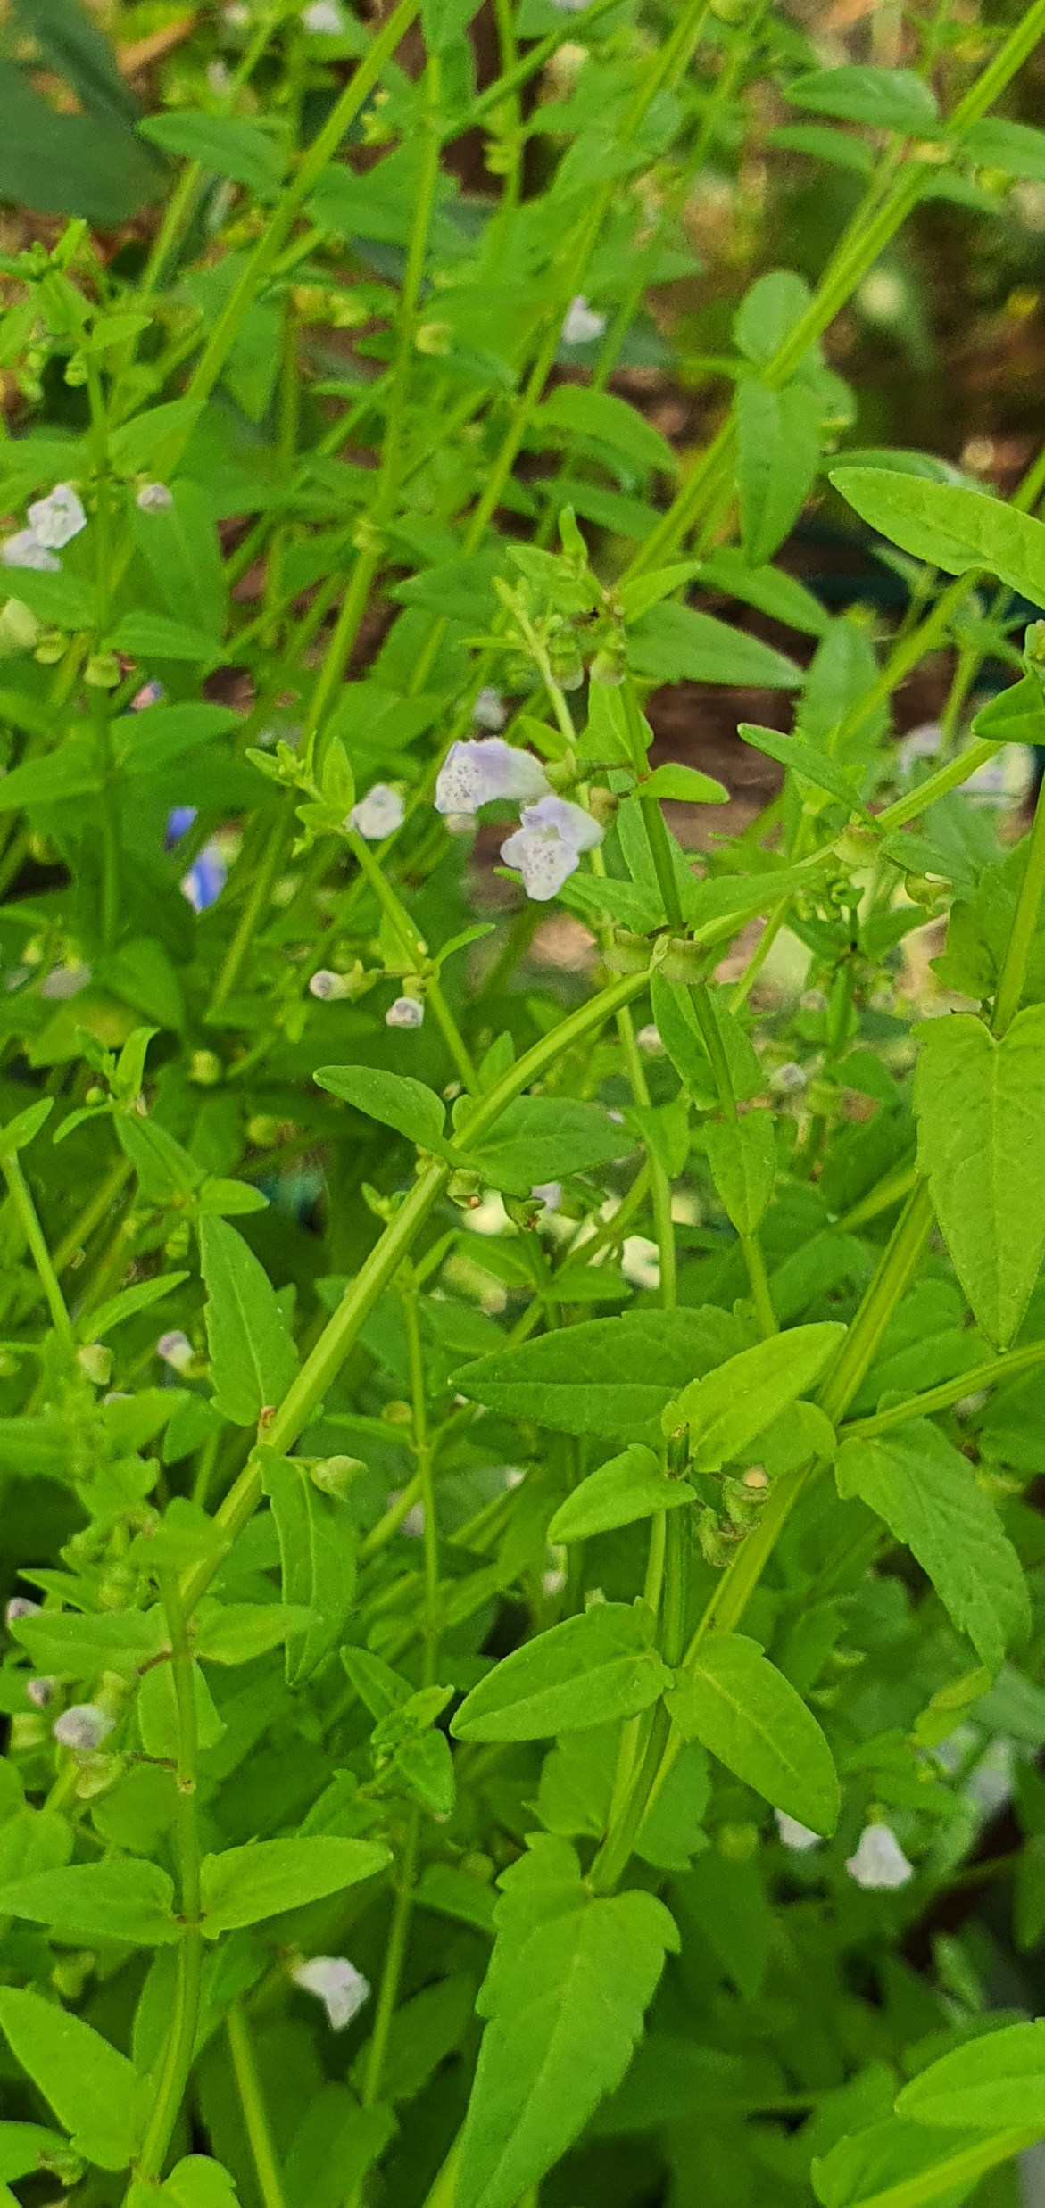
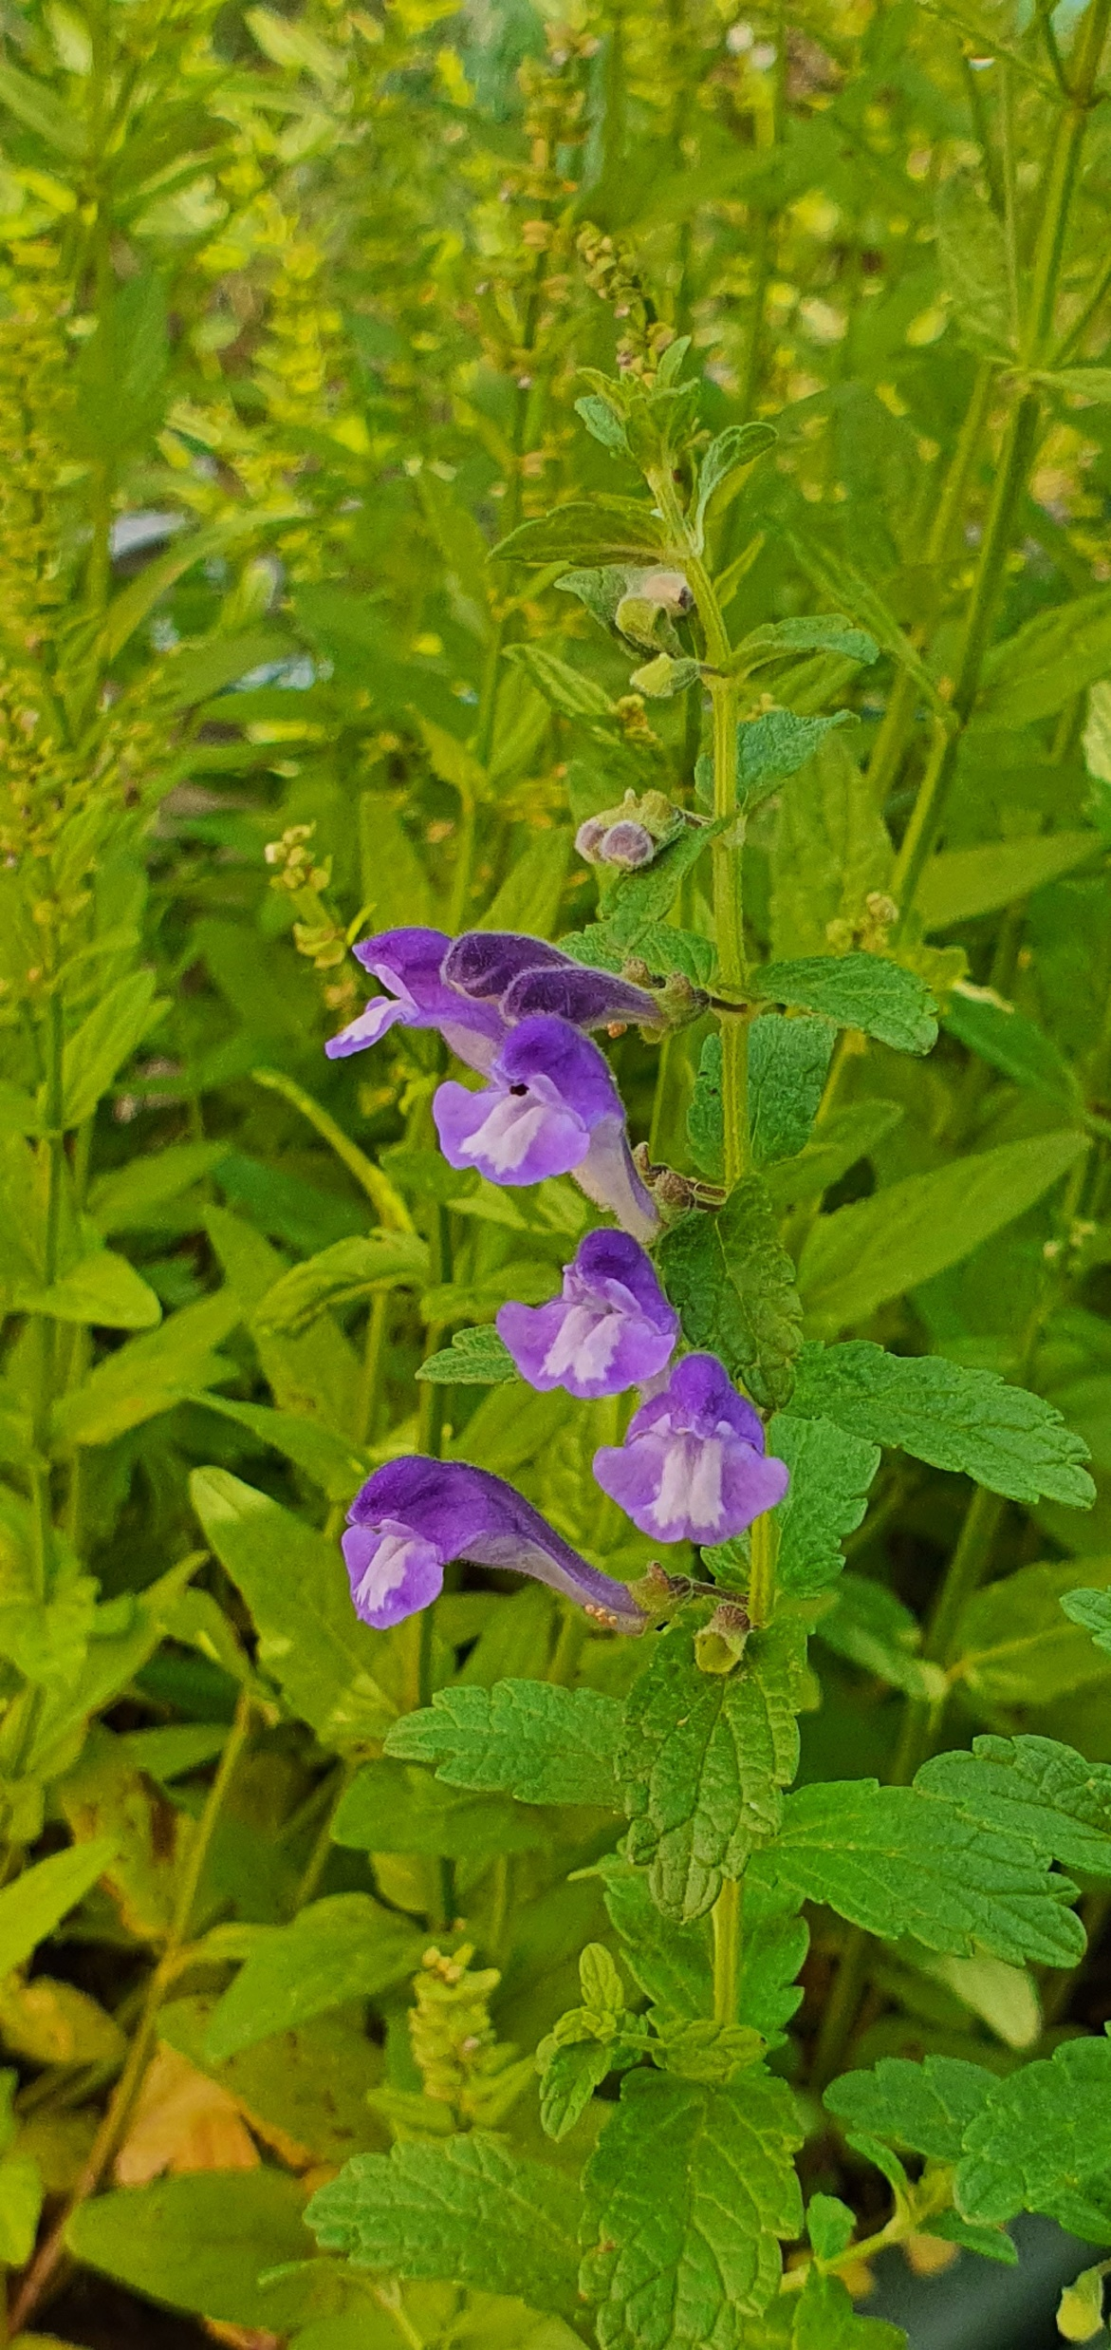
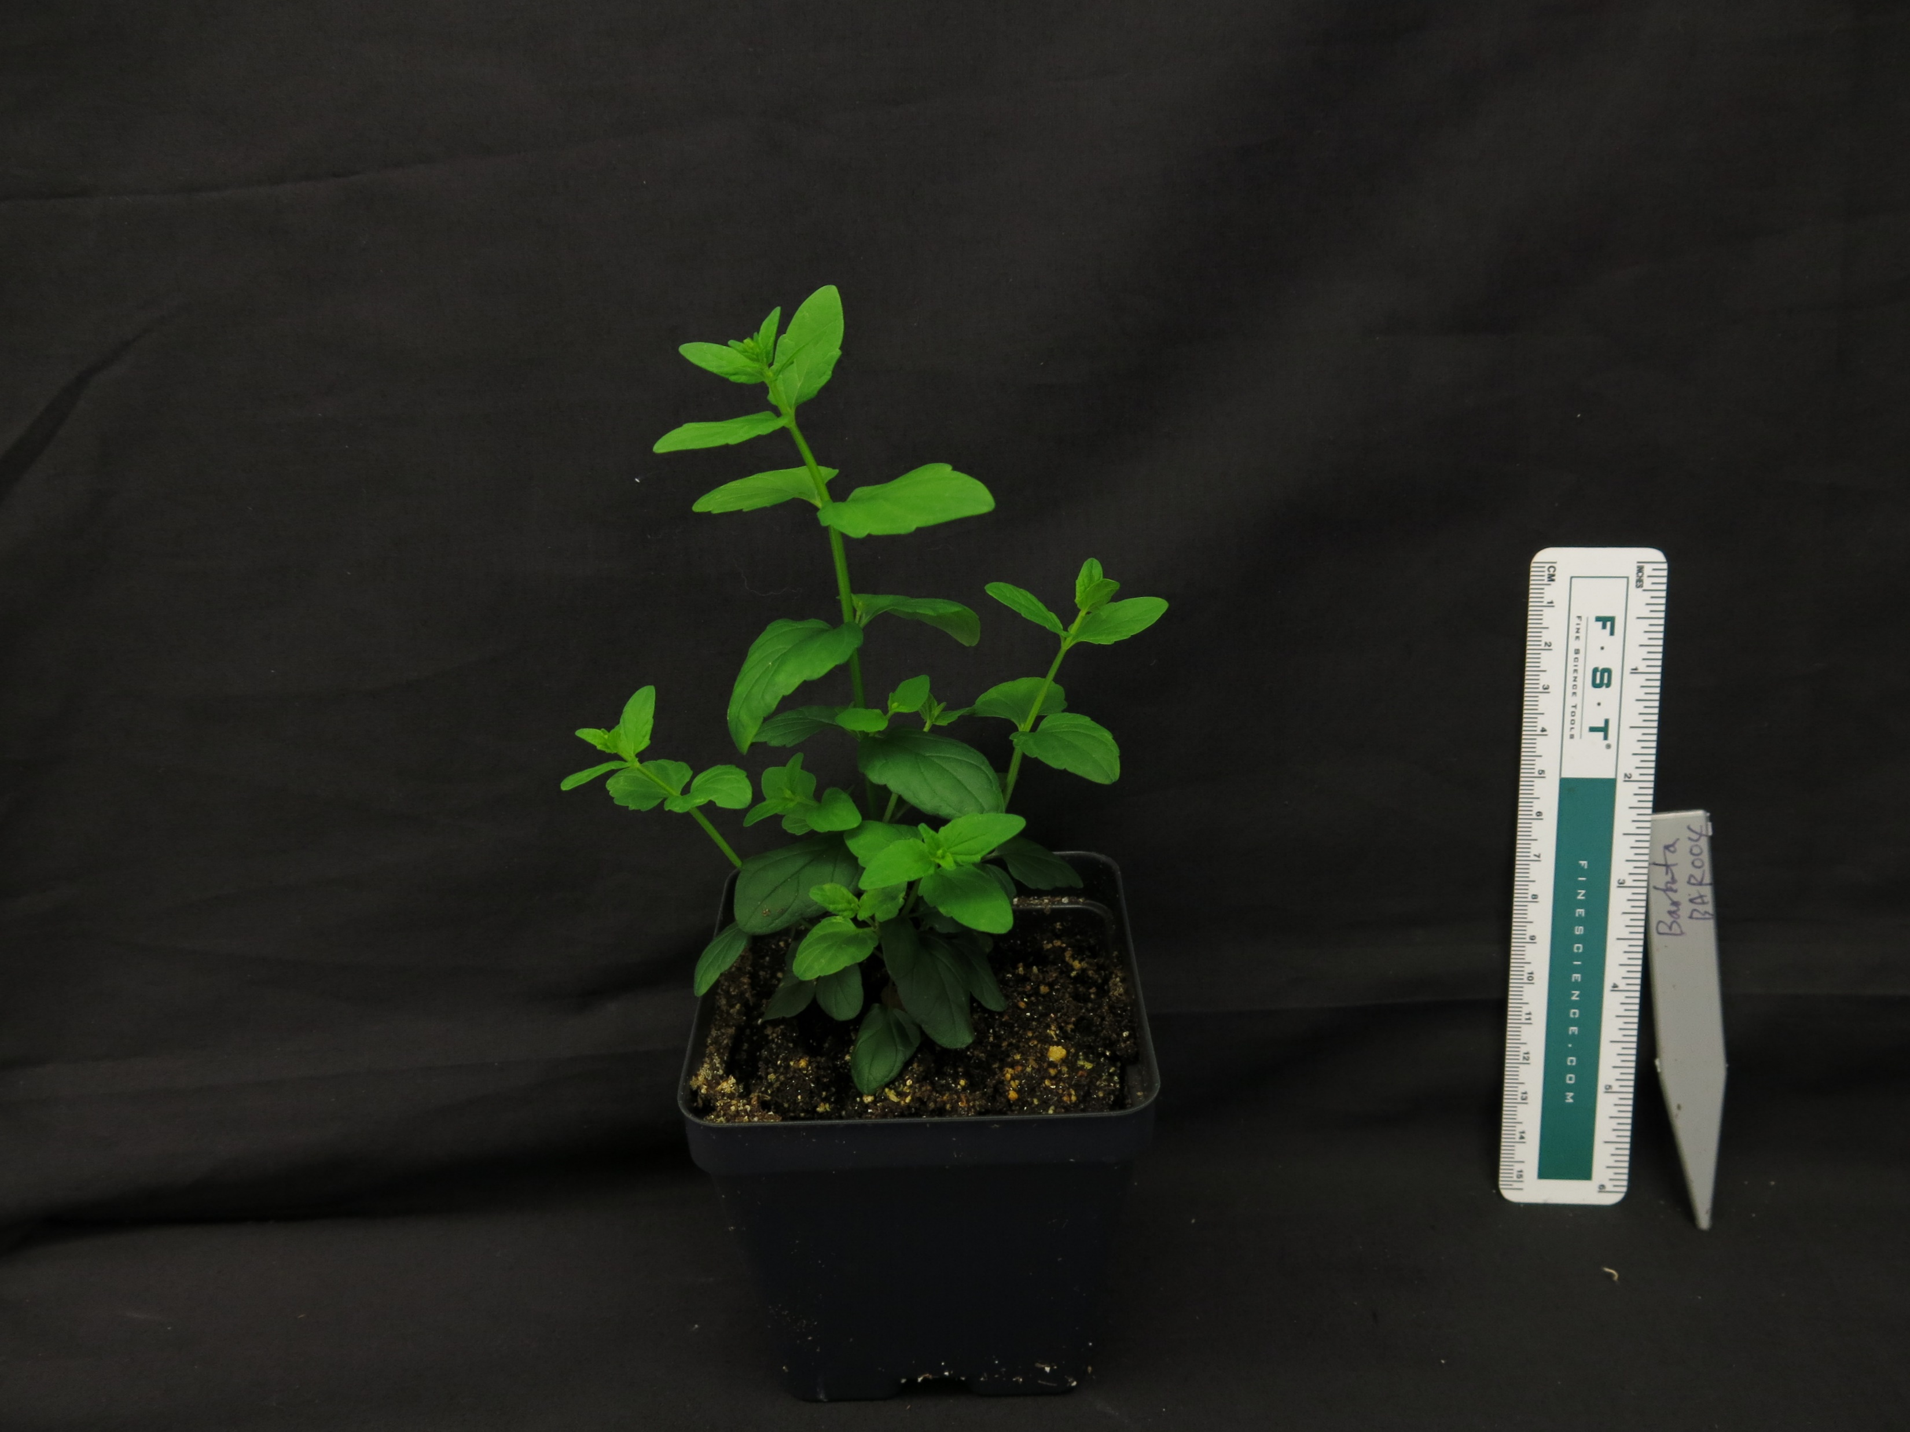
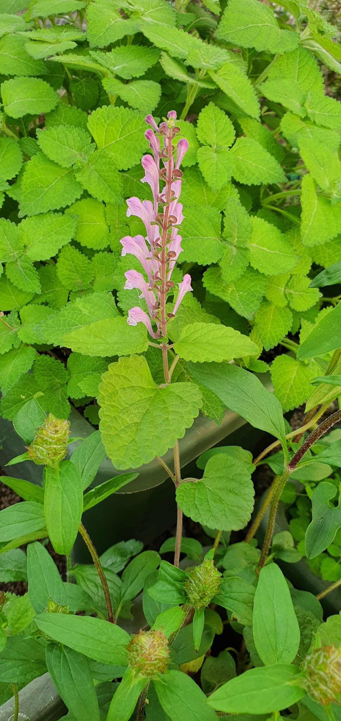
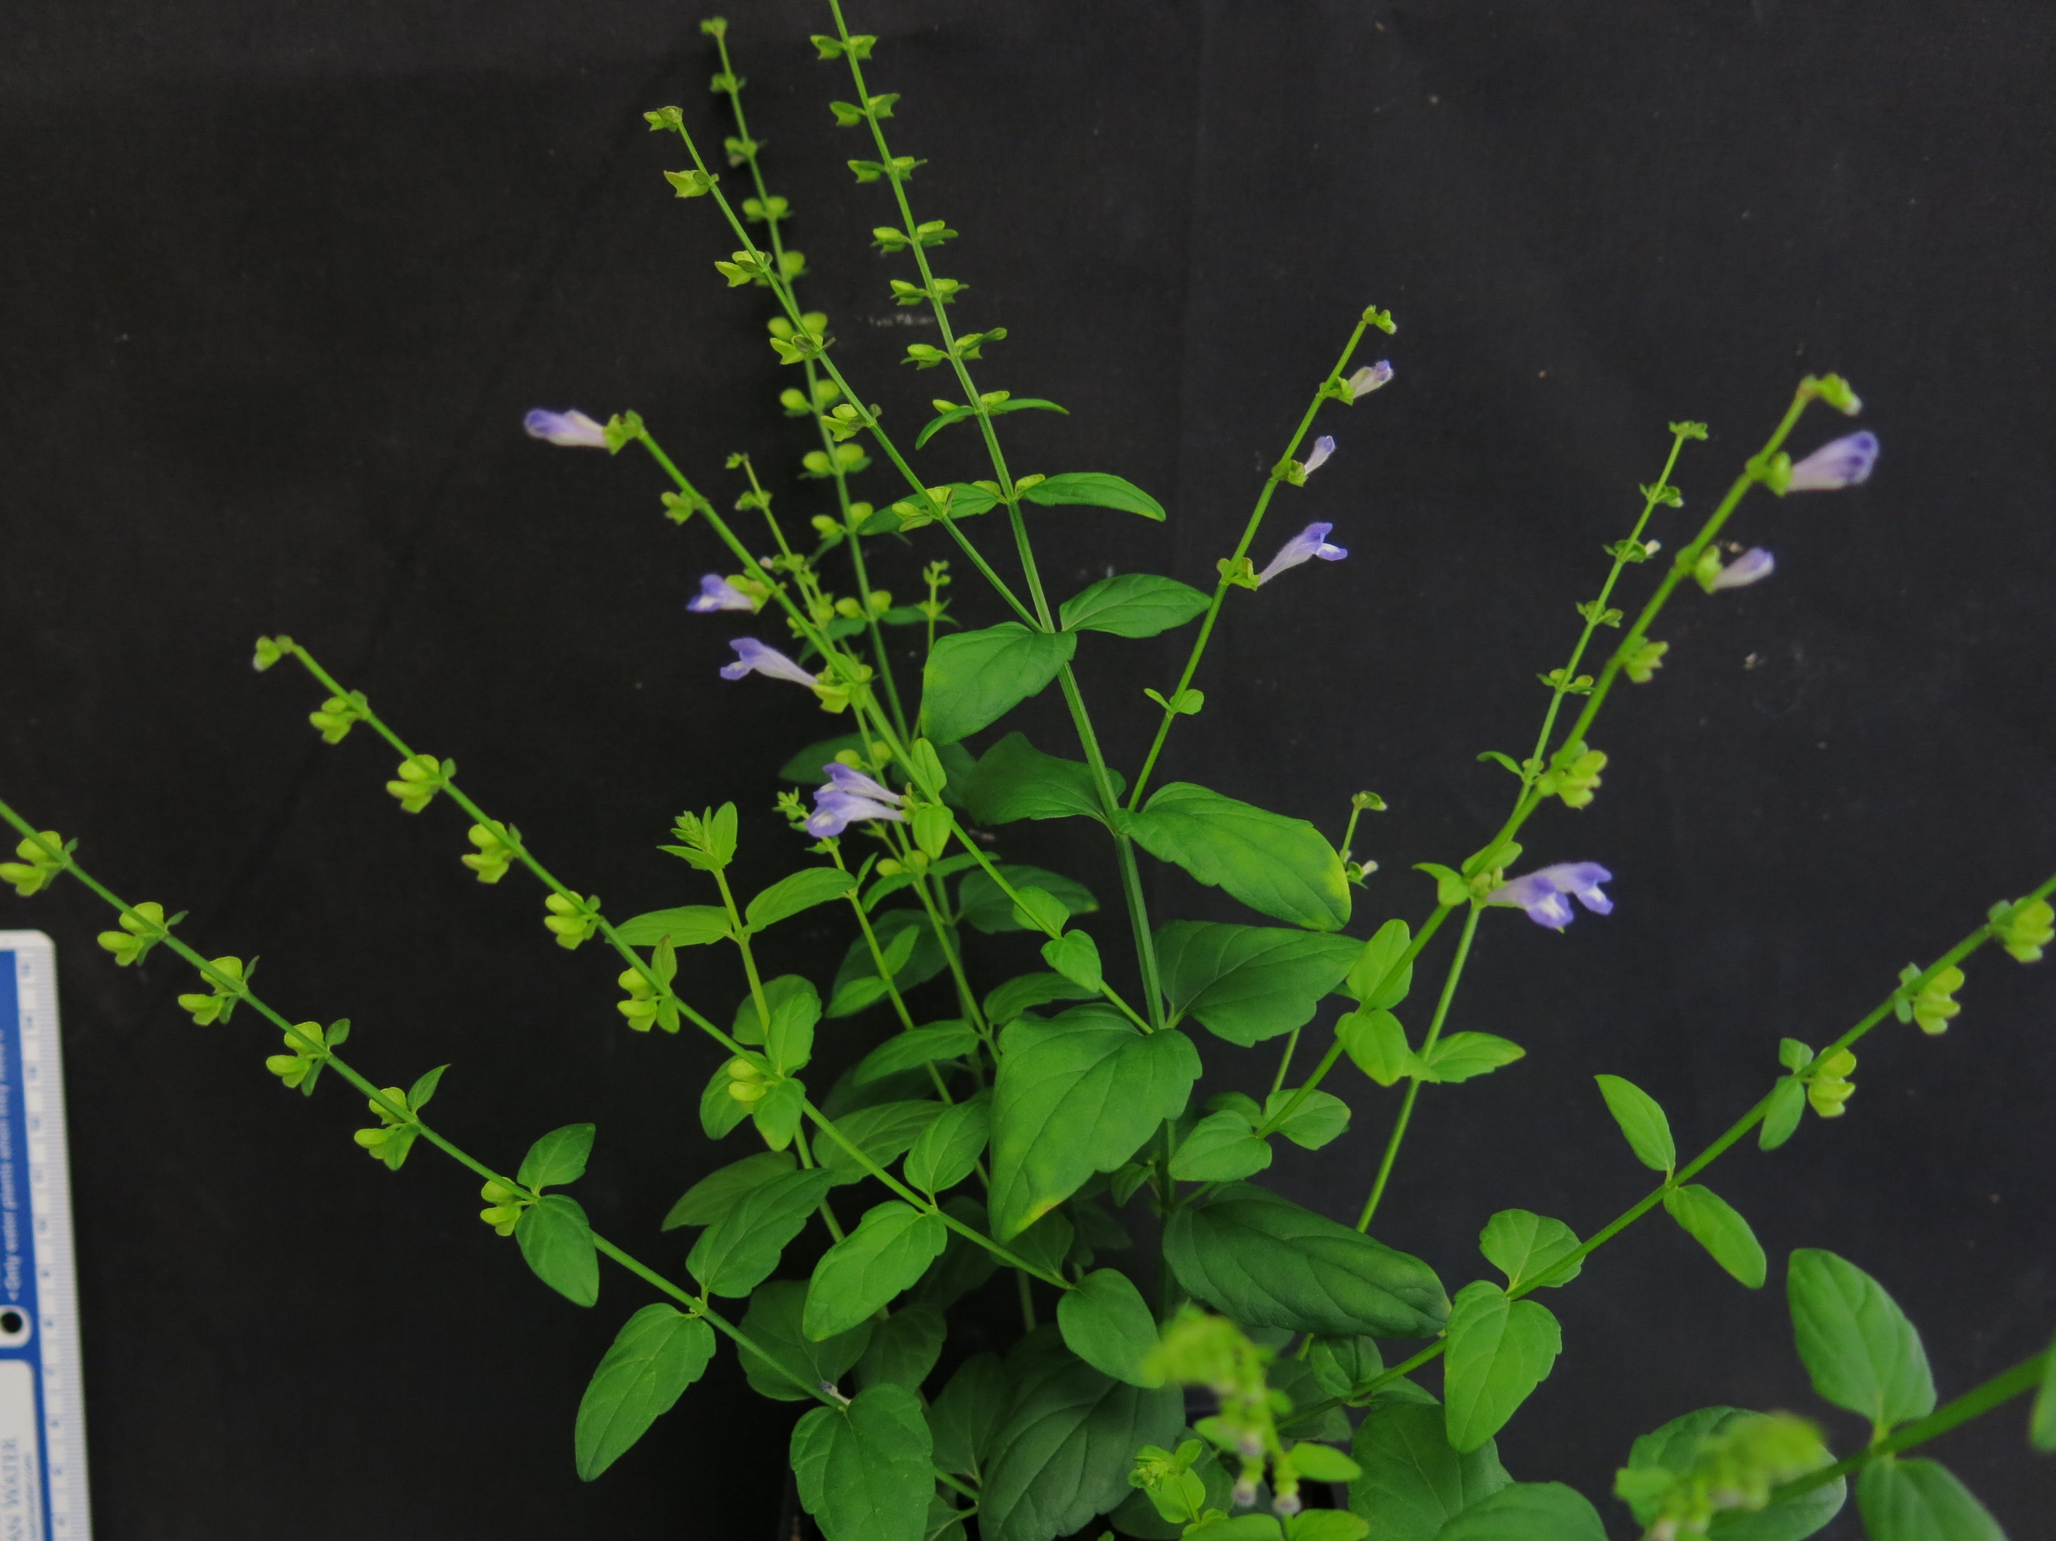
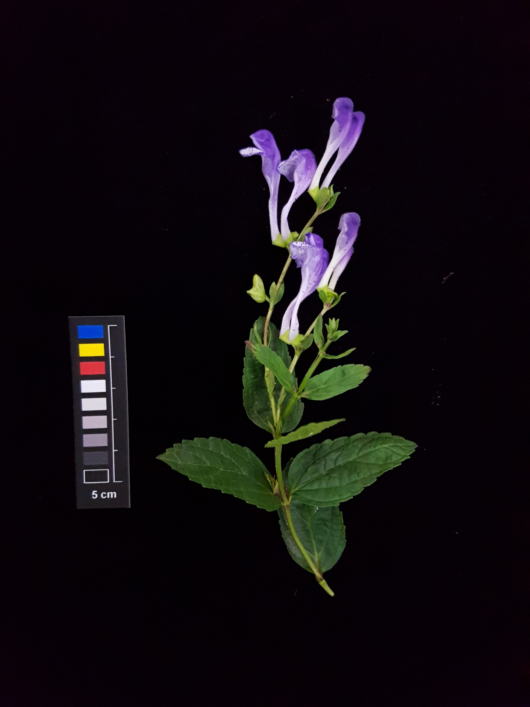
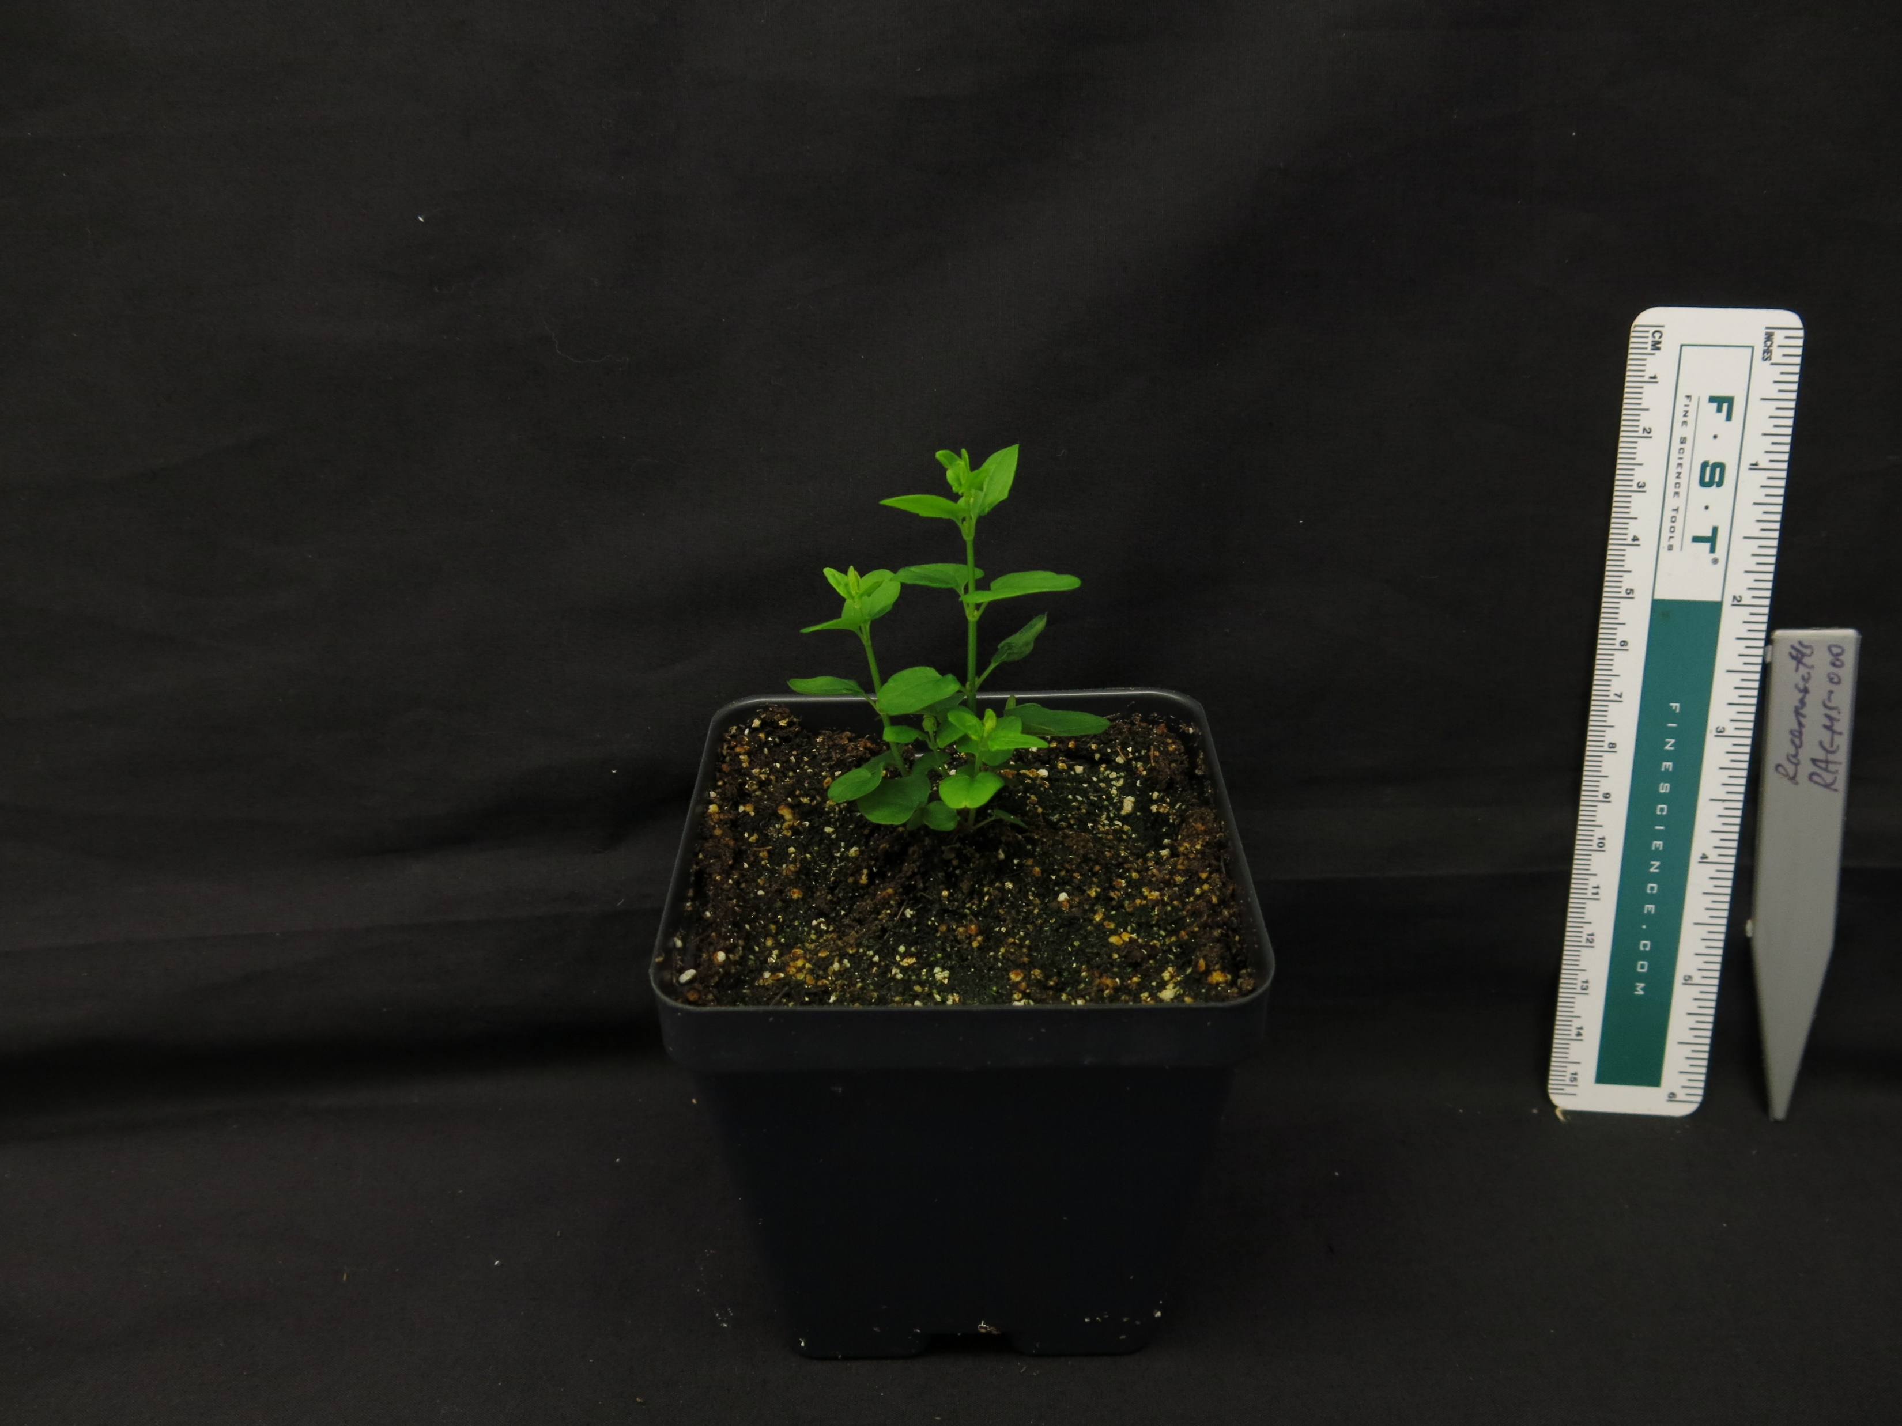
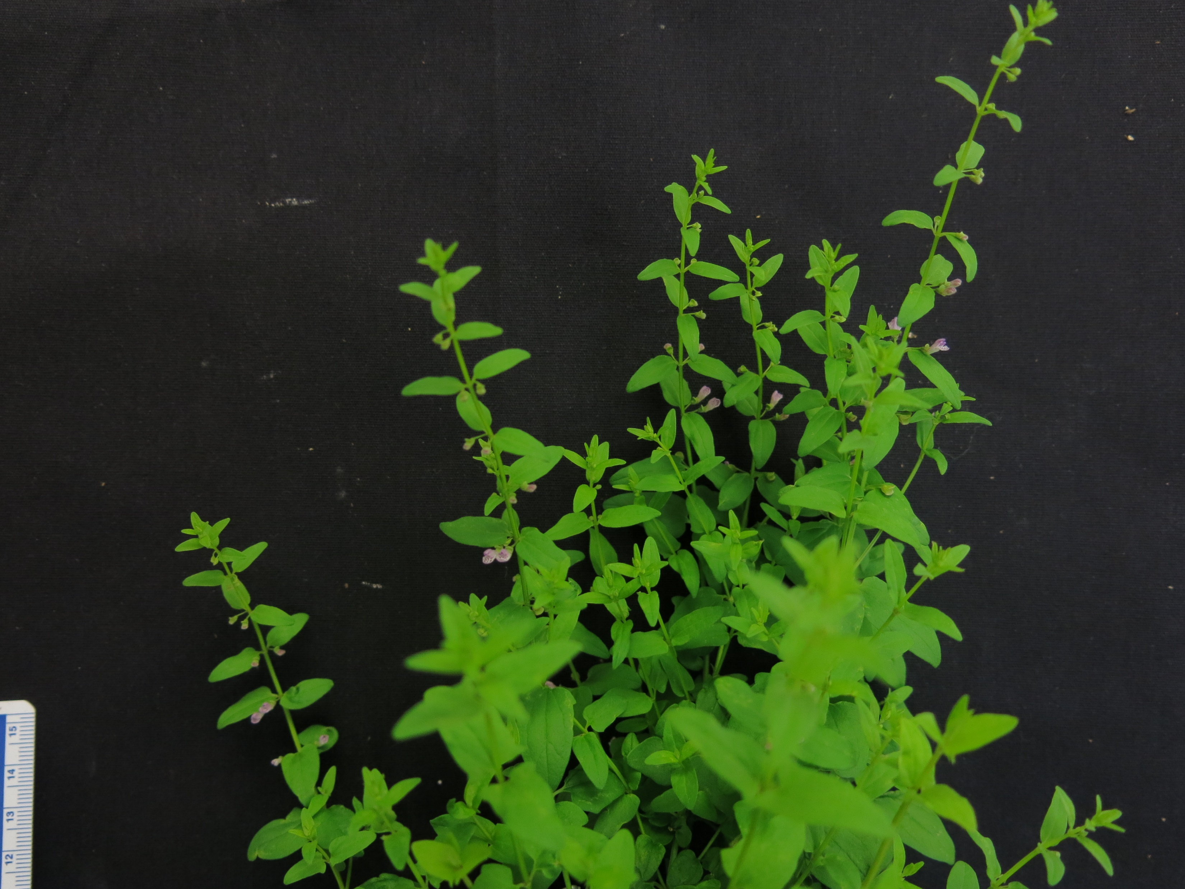
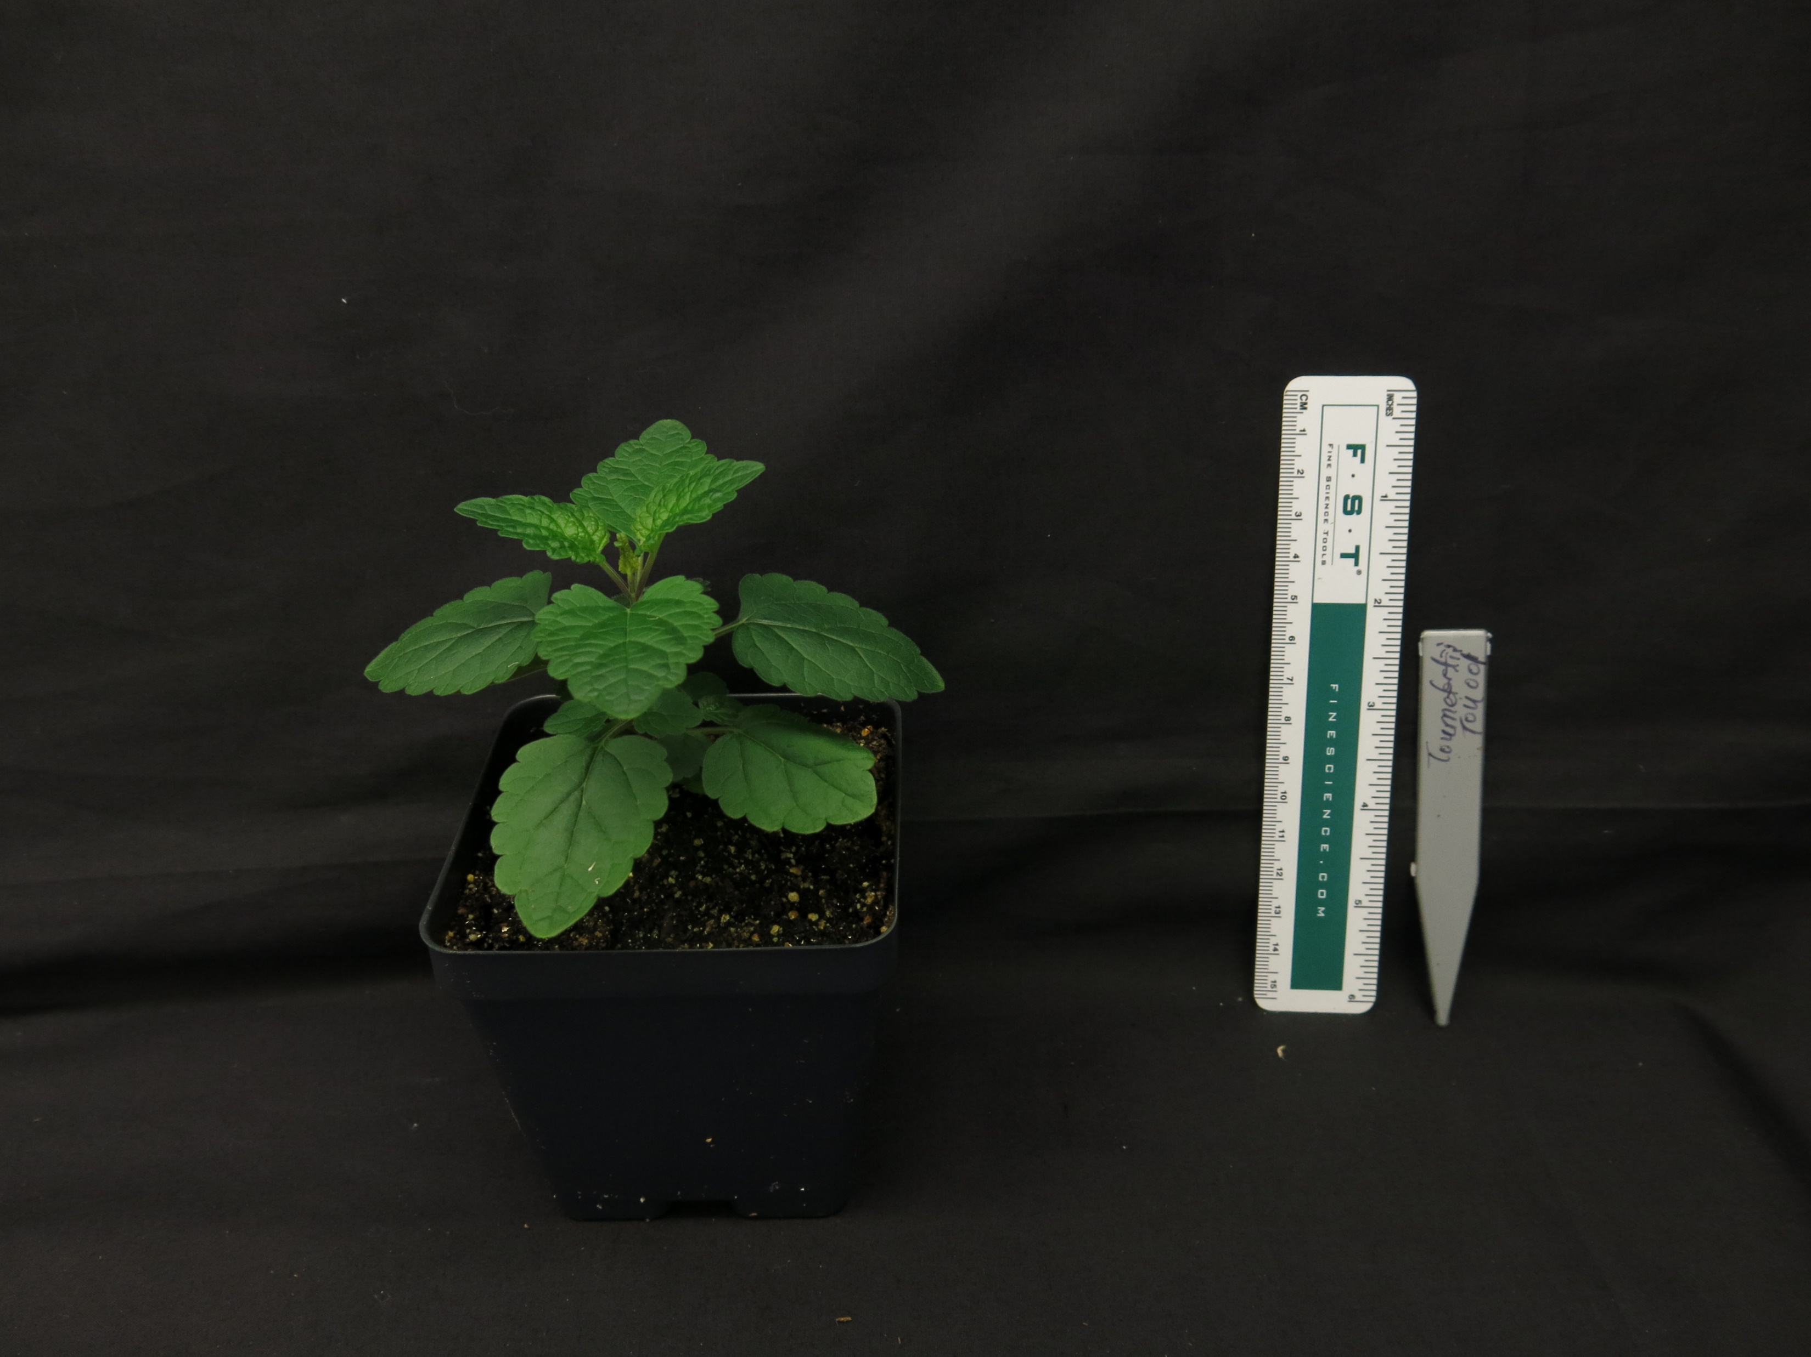
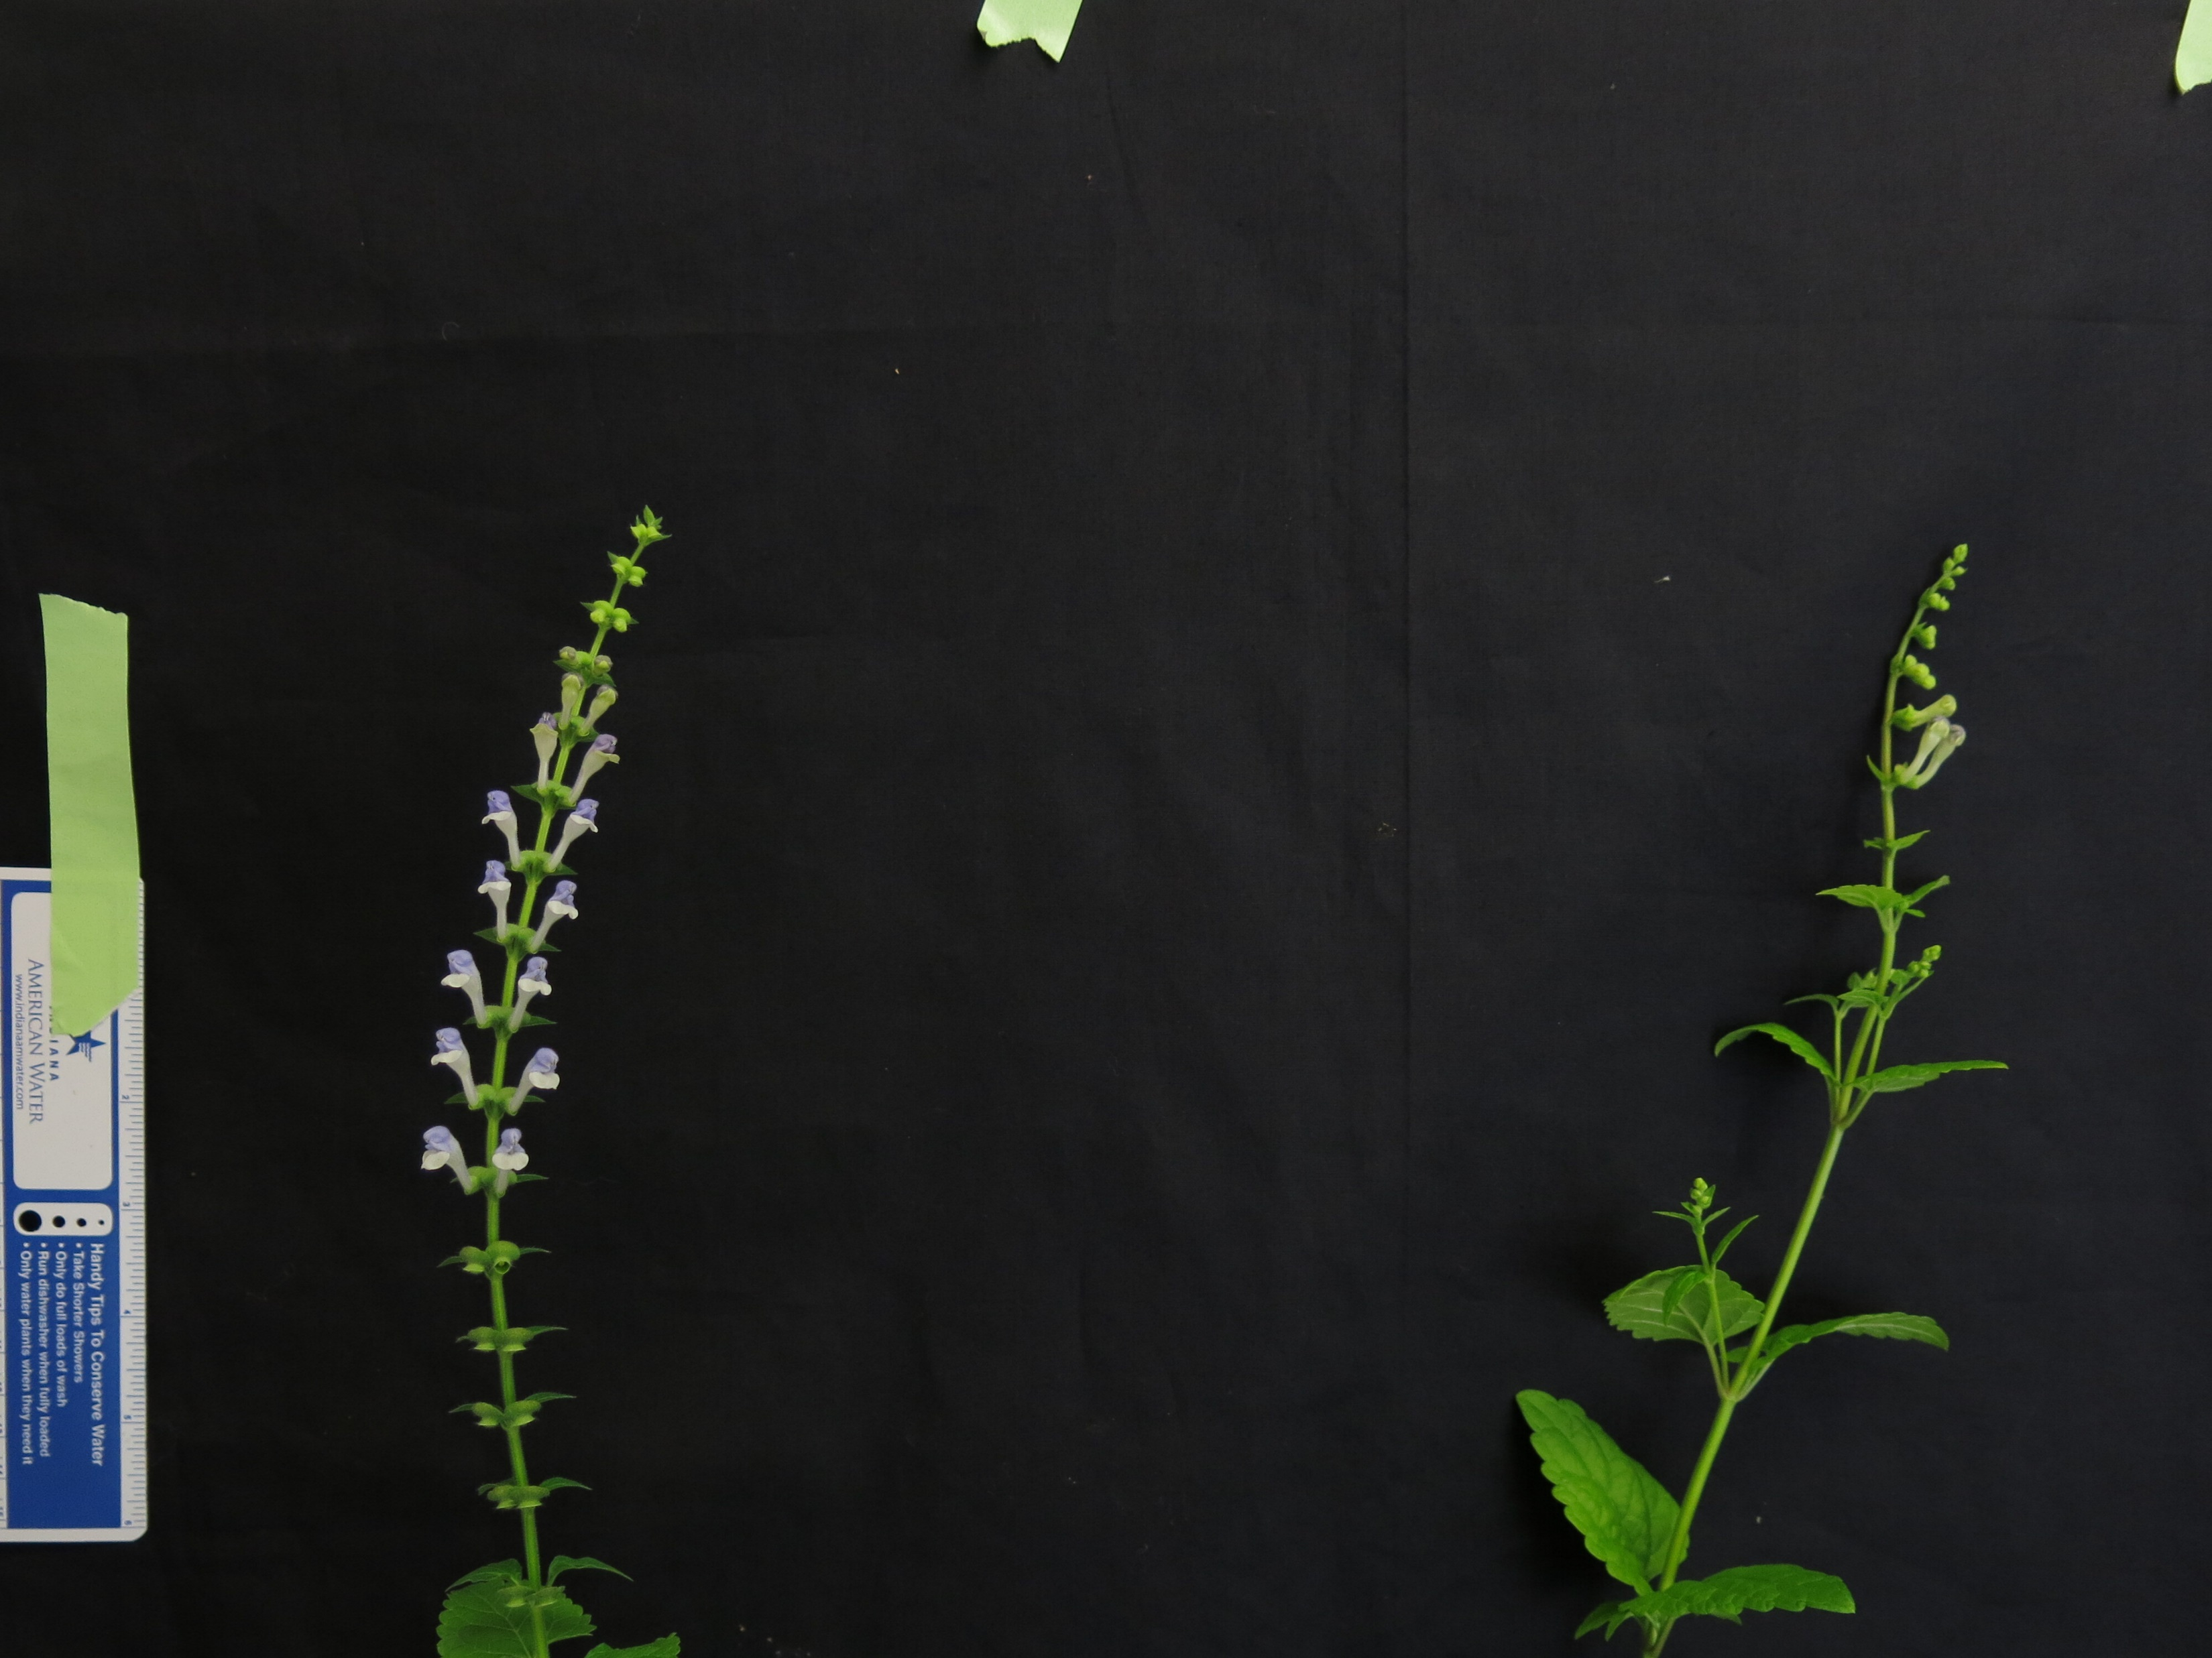
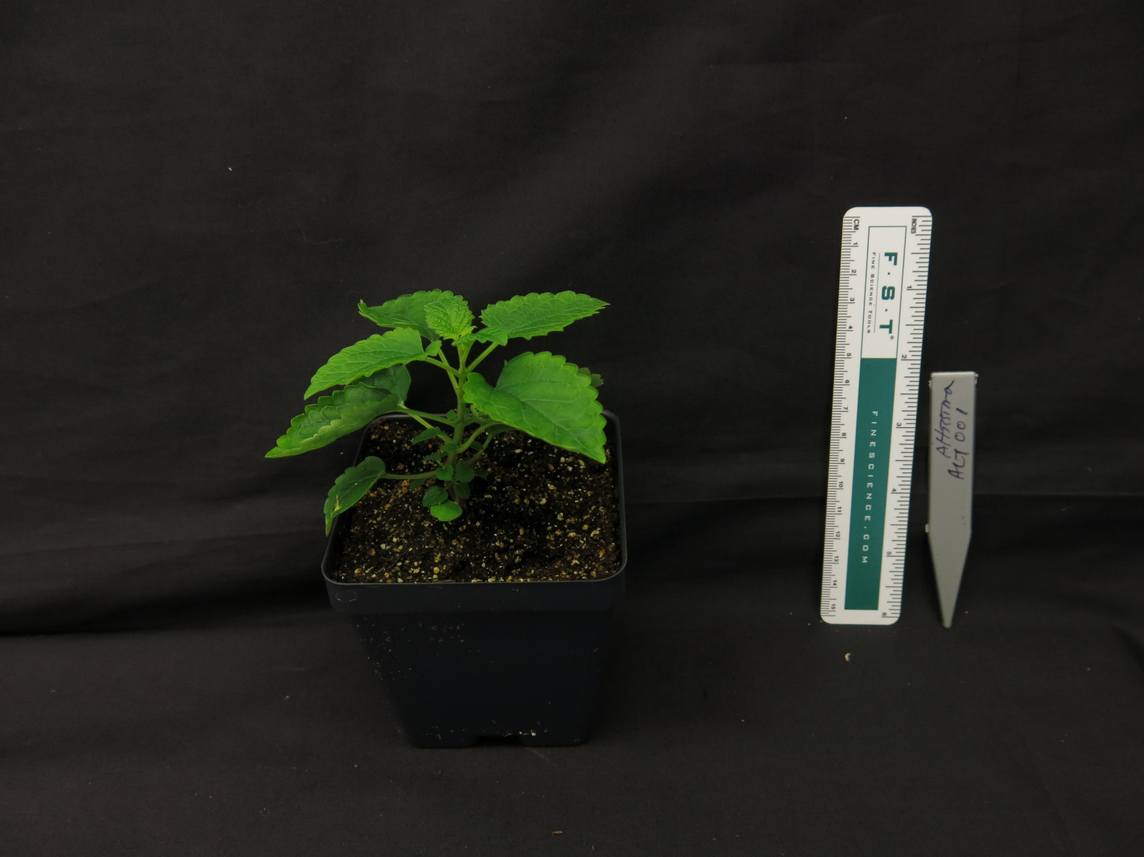
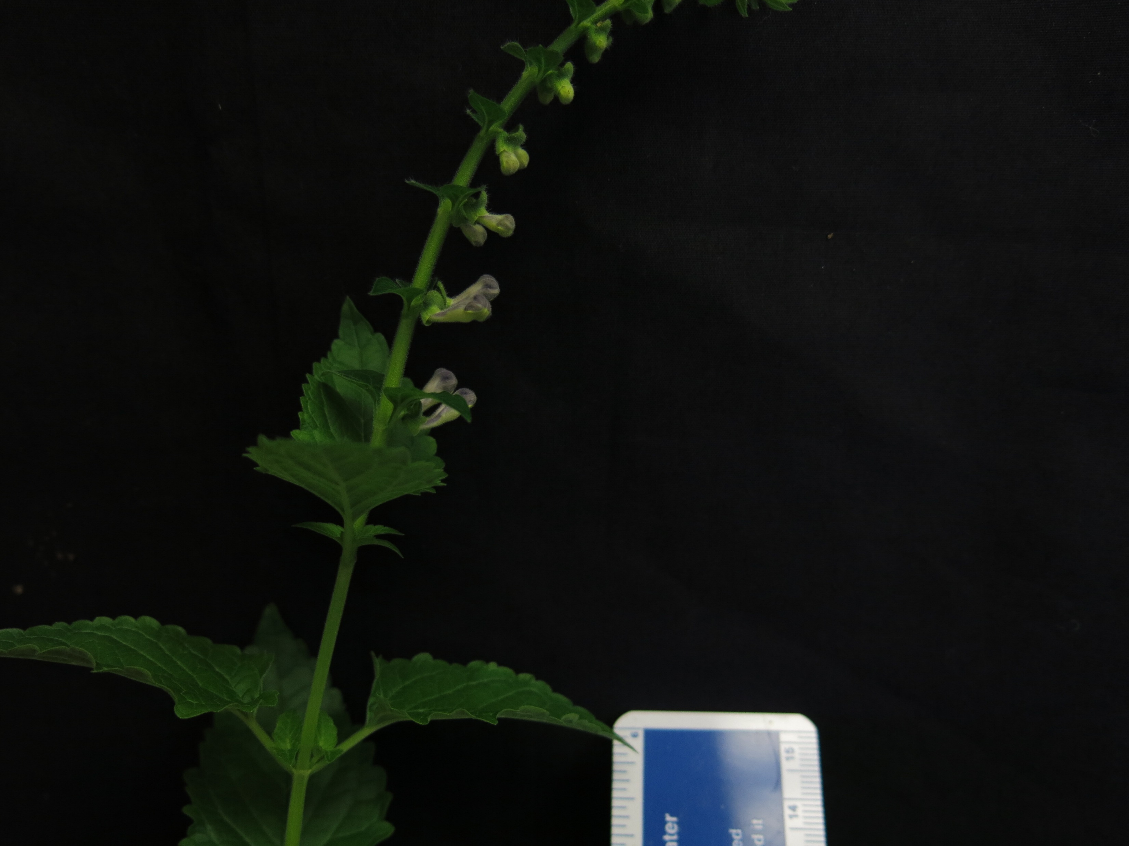
A.
B.
S. pekenensis var. alpina
S. baicalensis
S. havanensis
S. arenicola
S. dependens
S. strigillosa
S. barbata
S. indica var. coccinea
S. insignis
S. racemosa
S. tournefortii
S. altissima
Figure 1. (A) Maximum likelihood tree inferred from chloroplast genome data for 52 species of Scutellaria. To facilitate downstream analysis, the tree is subdivided into 6 clades. (B) Representative images of 12 species of Scutellaria. Scale bar in bottom left of images represents a length of 5 cm. Images without a scale bar didn’t have a ruler included in the image. Colored circles next to species names indicate the clade which the species belongs to.

Slide 5
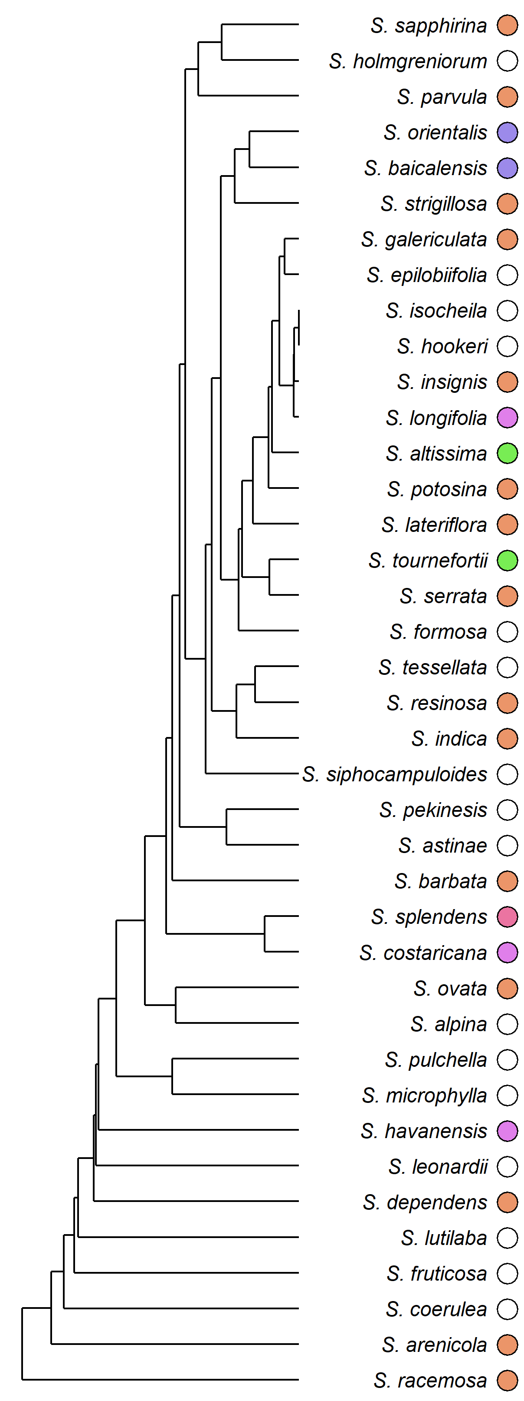
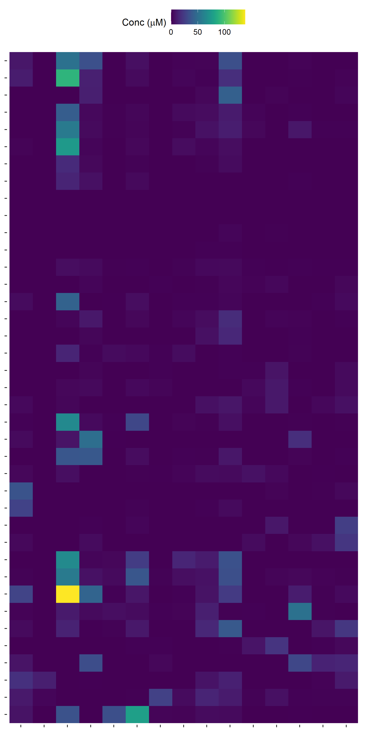
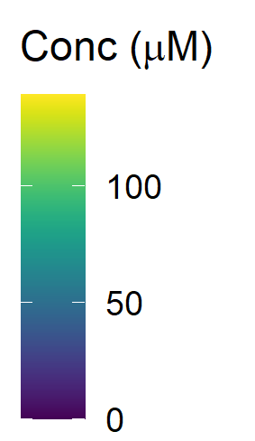
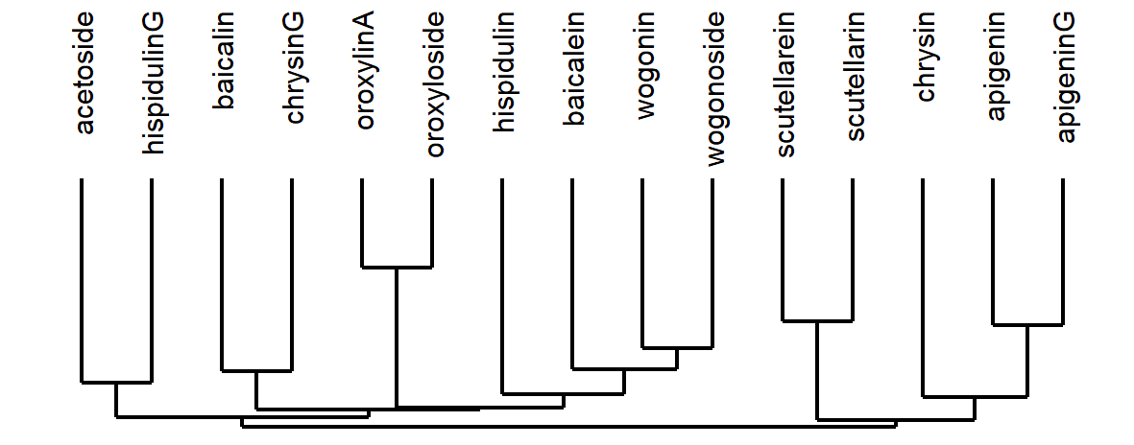
Figure 2. Heatmap of overall flavonoid concentrations measured with High Performance Liquid Chromatography (HPLC) of … species of Scutellaria. Ordering of species and flavonoids was determined by hierarchical clustering based on flavonoid concentration, as illustrated by the dendrogram to the right of and below the heatmap. Colored circles next to species names indicate phylogenetic clade, as shown in Figure 1. An empty circle indicates that the species was not included in the tree from Figure 1. Data for fresh tissue samples is shown at 5000 ppm (5 mg sample / 1 mL solvent). Data for herbarium tissue samples is shown at 500 ppm (0.5 mg sample / 1 mL solvent).

Slide 6
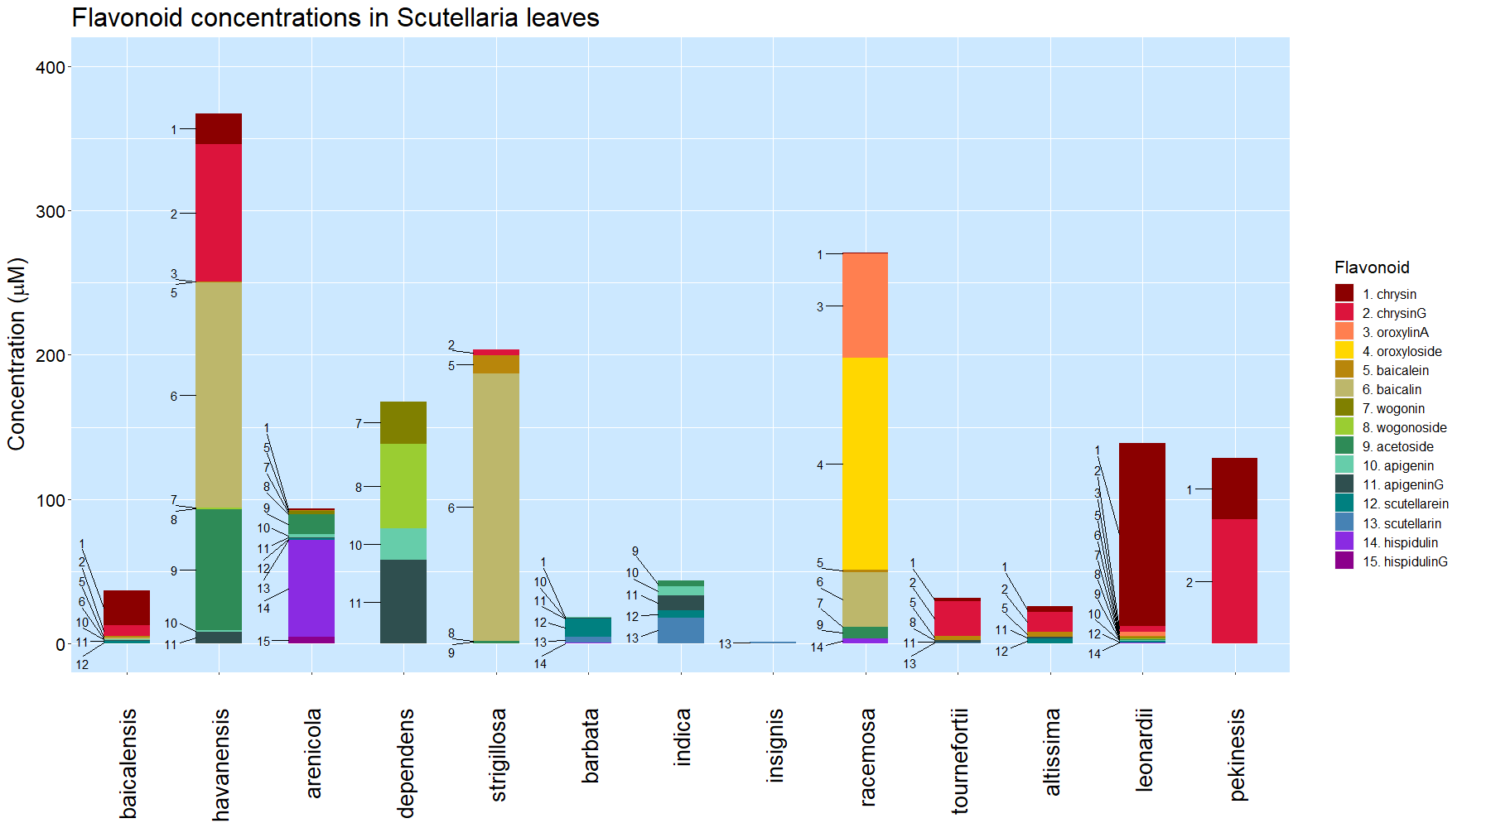
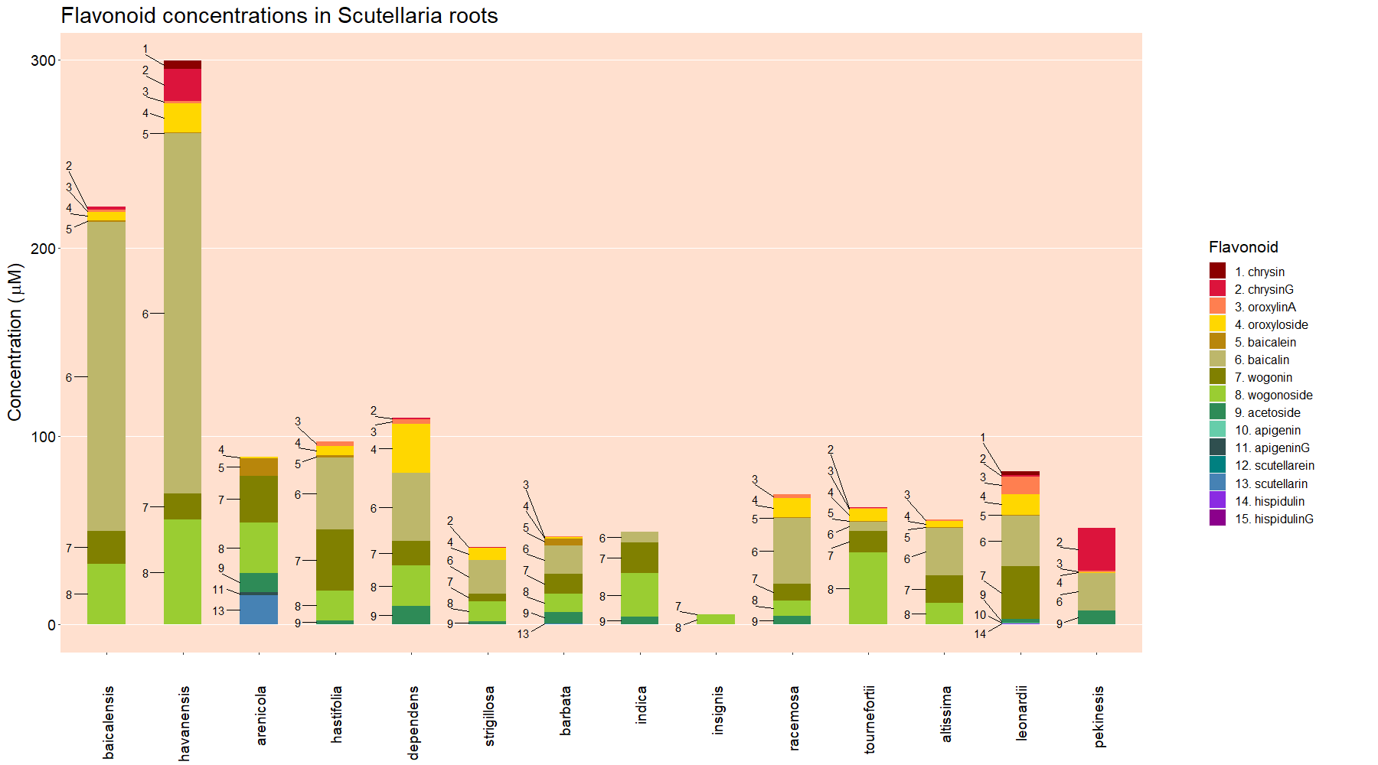
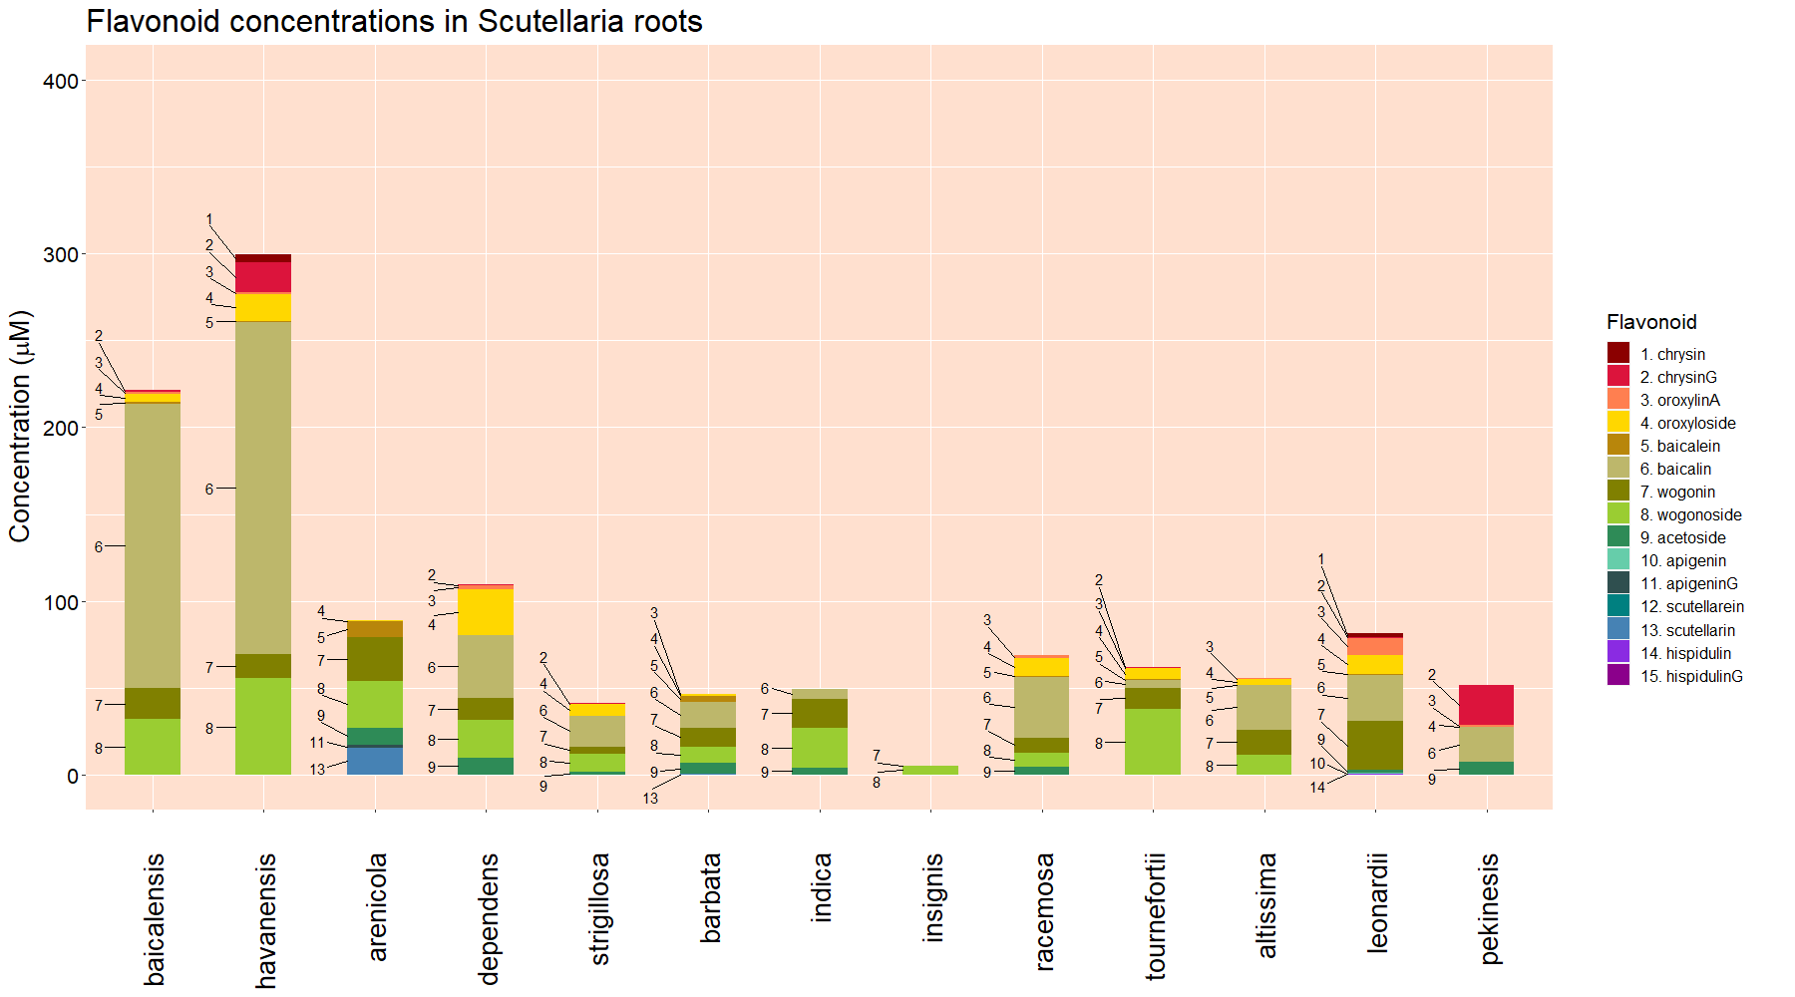
Leaves
Roots
Figure 3. Organ-specific flavonoid data collected from 14 Scutellaria species via High Performance Liquid Chromatography (HPLC). Species are ordered based on phylogenetic relationship determine from chloroplast genome data, shown in Figure 1. Colored circles next to species names indicate phylogenetic clade, as shown in Figure 1. An empty circle indicates that the species was not included in the tree from Figure 1. Flavonoids are ordered based on proposed flavonoid pathway for S. baicalensis.

Slide 7
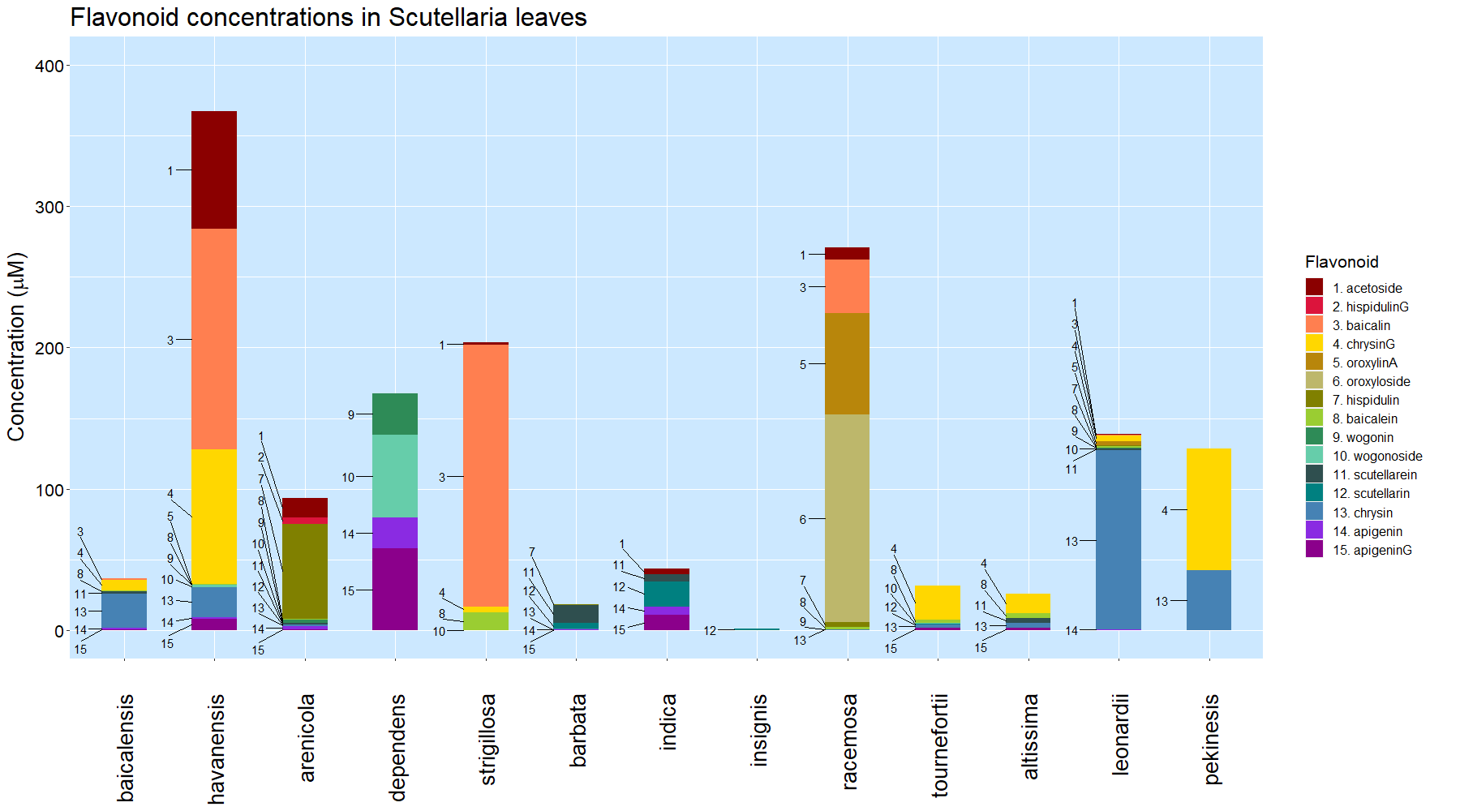
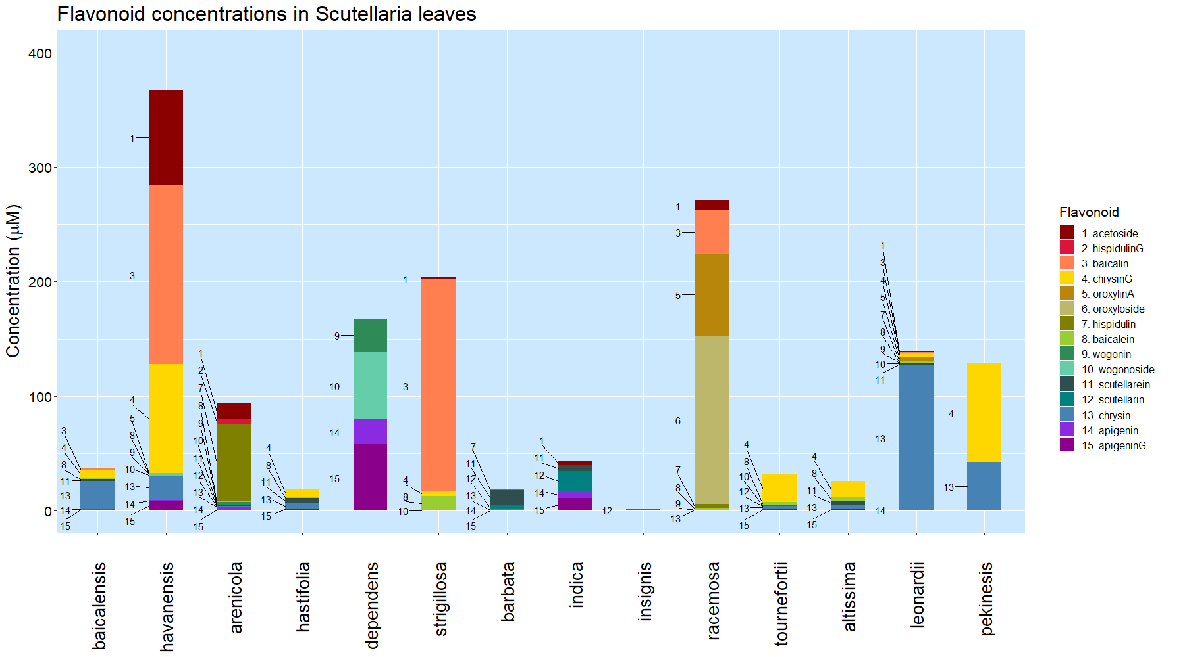
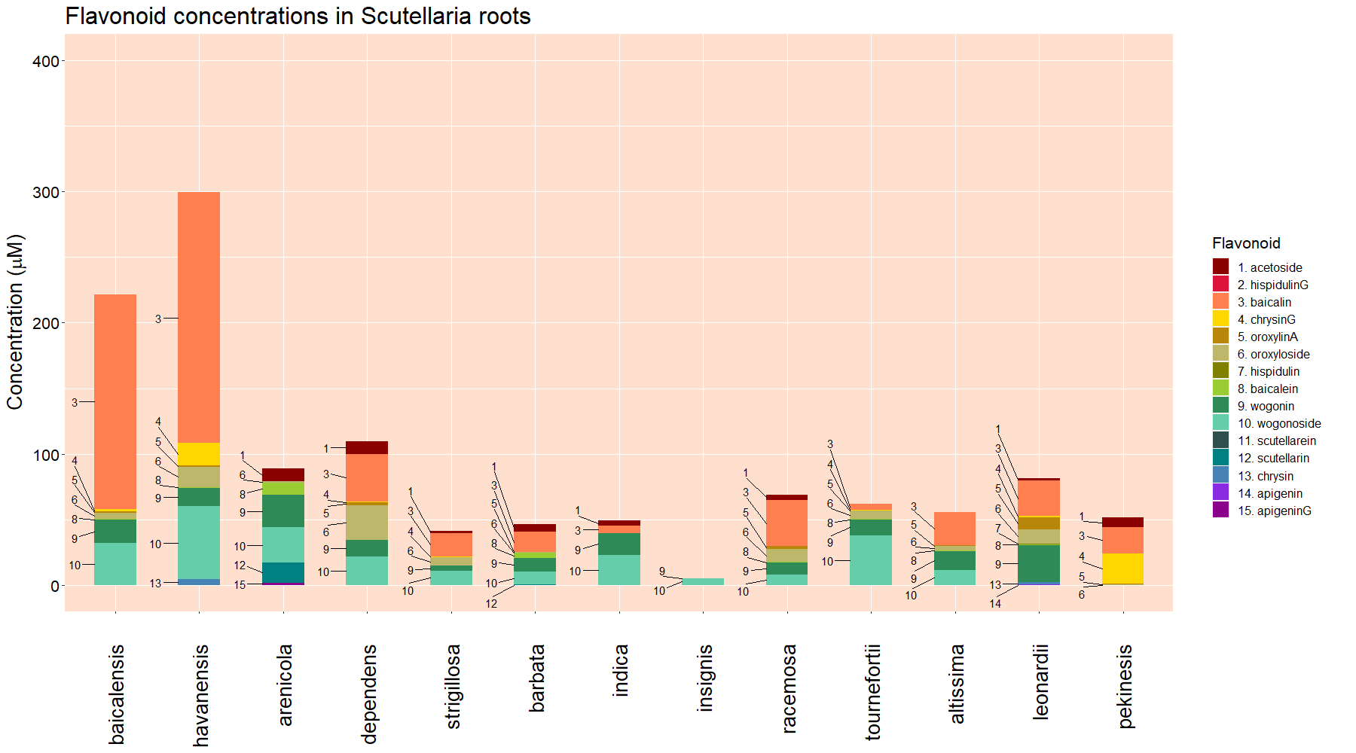
Leaves
Roots
Figure 3. Organ-specific flavonoid data collected from 14 Scutellaria species via High Performance Liquid Chromatography (HPLC). Species are ordered based on phylogenetic relationship determine from chloroplast genome data, shown in Figure 1. Colored circles next to species names indicate phylogenetic clade, as shown in Figure 1. An empty circle indicates that the species was not included in the tree from Figure 1. Flavonoids are ordered based on hierarchical clustering determined previously, illustrated in Figure 2.

Slide 8
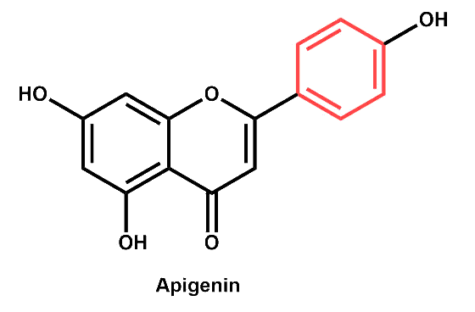
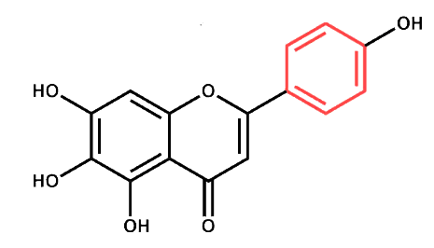
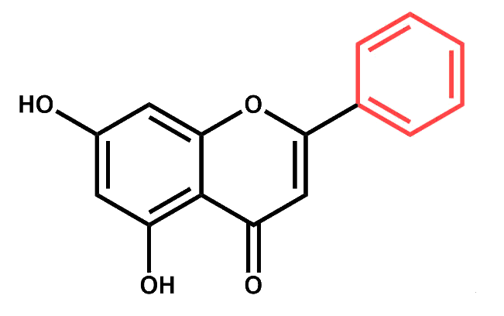
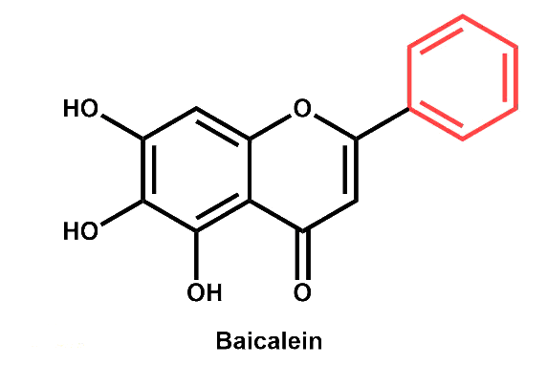
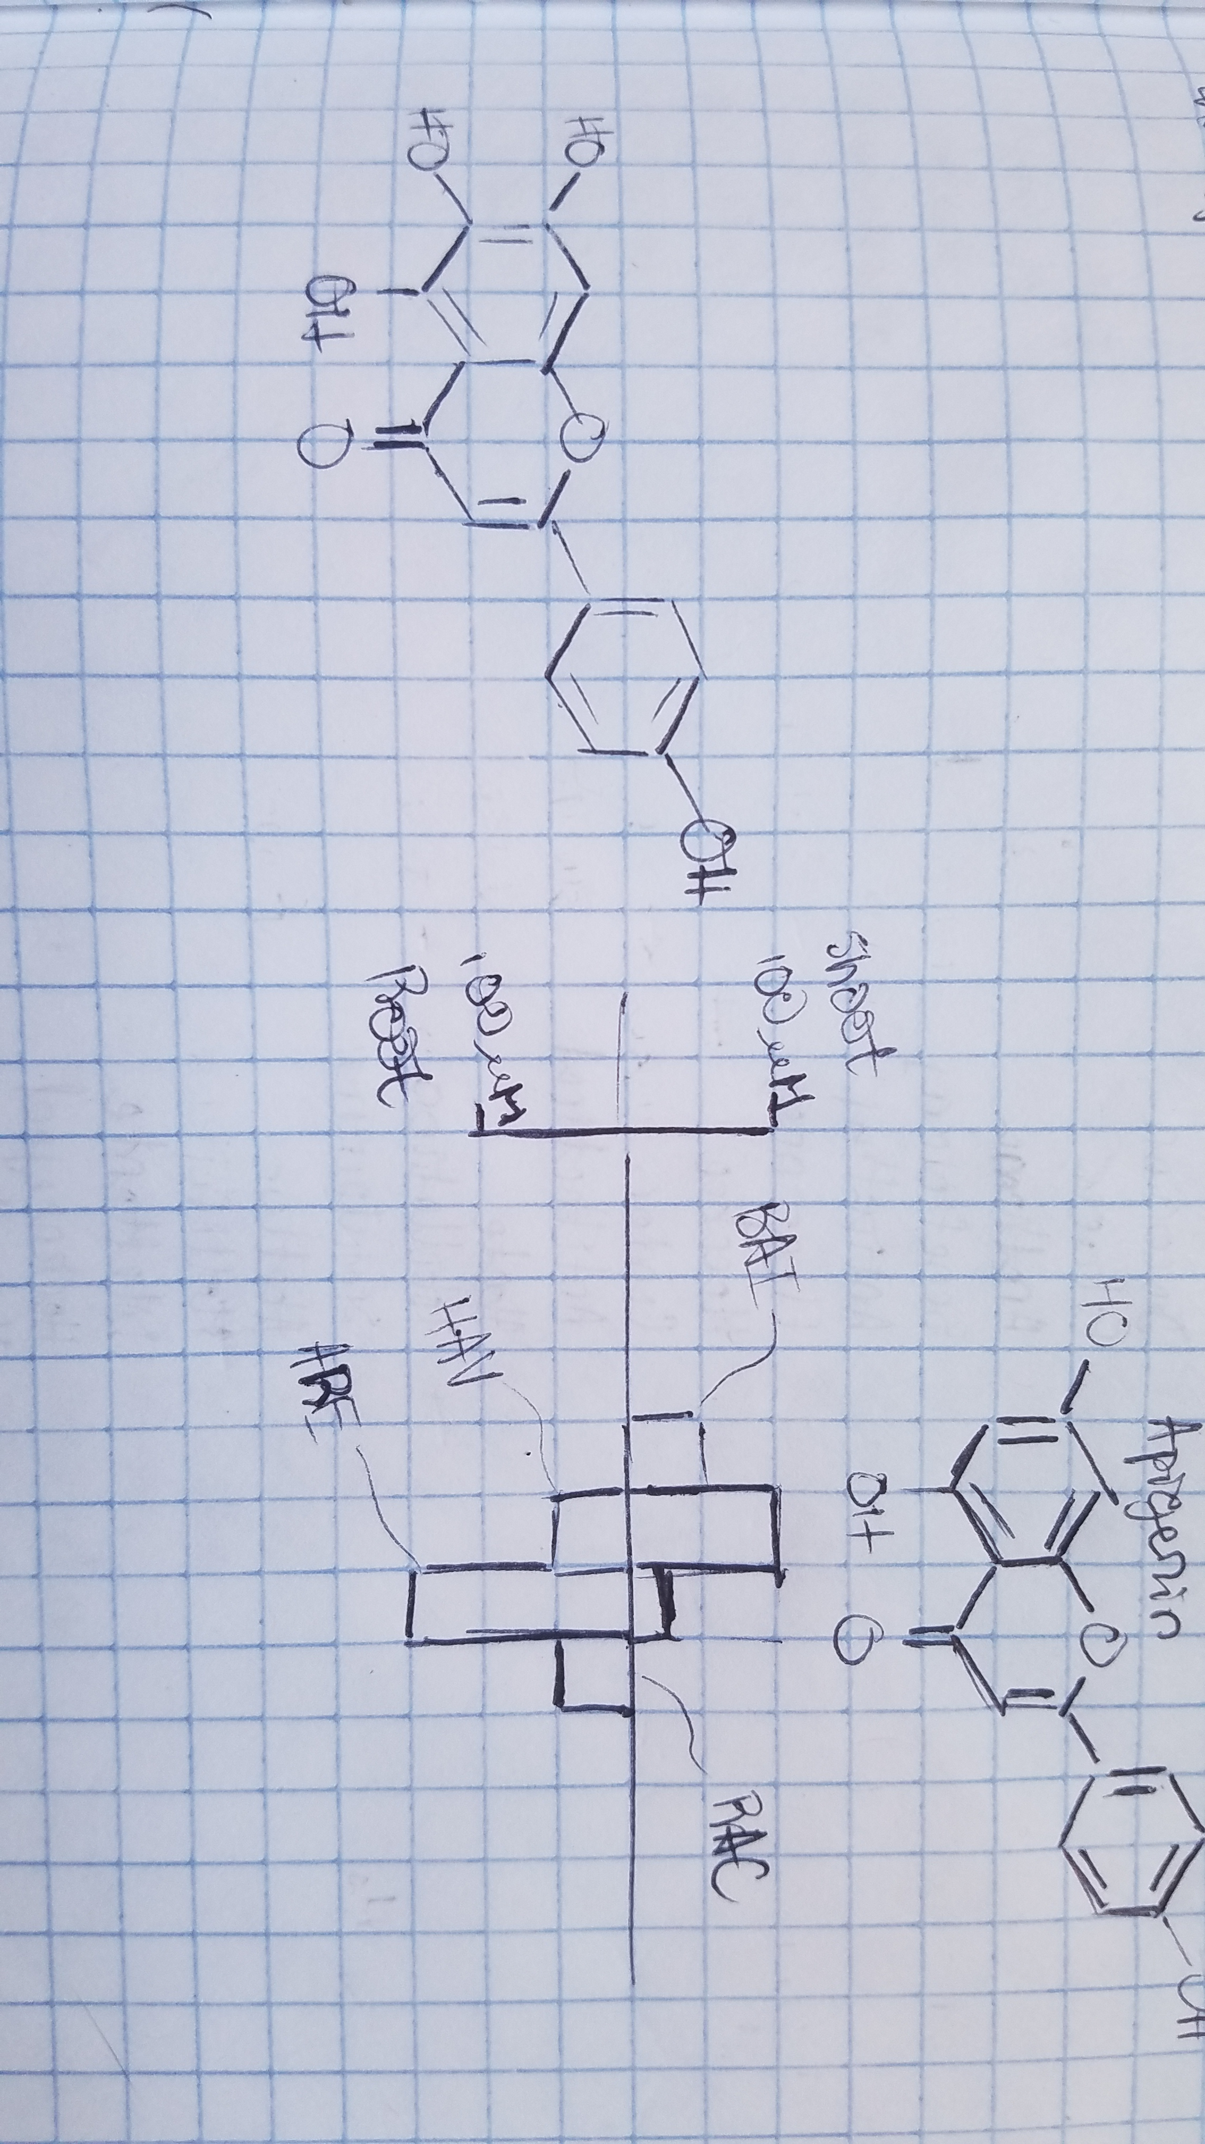
Published
Proposed to occur in shoots
Proposed to occur in roots
4-coumarate
Apigenin
Scutellarein
Phenylalanine
Cinnamic acid
Cinnamoyl-CoA
Chrysin
Baicalein
Figure 4. Proposed

Slide 9
Table 1. Genome sizes as estimated by flow cytometry. Cell colors indicate phylogenetic clade, as shown in Figure 1.
Species | Estimated genome size (Gbp)
 | Measured in this study | Published previously
S. baicalensis | 0.54 | 0.38 (Xu et al., 2020), 0.41 (Zhao et al., 2019), 0.41 (Cole et al., 2008)
S. havanensis | 0.37
S. arenicola | 0.85
S. dependens | 0.44
S. strigillosa | n.d. | 0.38 (Lee & Kim, 2017)
S. barbata | 0.52 | 0.35 (Xu et al., 2020)
S. indica var. coccinea | n.d. | 0.38 (Lee & Kim, 2017)
S. insignis | n.d. | 0.46 (Lee & Kim, 2017)
S. racemosa | 0.44 | 0.37 (Cole et al., 2008)
S. tournefortii | 0.39
S. altissima | 0.39
S. leonardii | 0.50
S. pekenensis | 0.38 | 0.45 (Lee & Kim, 2017)

